Slide 1
Technology and Solutions Summit 2016
#HPETSS
Fabien GIRAUD / HPE Aruba SE
June 12, 2016
Notes:
This is a sample Title Slide with Picture ideal for including a dark picture with a brief title and subtitle.
A selection of pre-approved title slides are available in the HPE Title Slide Library. The location of the library will be communicated later.
To insert a slide with a different picture from the HPE Title Slide Library:
Open the file HPE_16x9_Title_Slide_Library.pptx
From the Slide thumbnails pane, select the slide with the picture you would like to use in your presentation and click Copy (Ctrl+C)
Open a copy of the new HPE 16x9 template (Standard or Events) or your current presentation
In the Slide thumbnails pane, click Paste (Ctrl+V)
A Paste Options clipboard icon will appear. Click the icon and select Keep Source Formatting. (Ctrl+K)

Slide 2

Please give us your feedback

Slide 3
Confidential Disclosure Agreement
The information contained in this presentation is proprietary to Hewlett Packard enterprise and is offered in confidence, subject to the terms and conditions of a binding Confidential Disclosure Agreement (CDA)
HPE requires customers and partners to have signed a CDA in order to view this training
The information contained in this training is HPE confidential
This presentation is NOT to be used as a ‘leave behind’ for customers and information may only be shared verbally with HPE external customers under NDA
This presentation may be shared with Partners under NDA in hard-copy or electronic format for internal training purposes only
Do not remove any classification labels, warnings or disclaimers on any slide or modify this presentation to change the classification level.
Do not remove this slide from the presentation
HPE does not warrant or represent that it will introduce any product to which the information relates
The information contained herein is subject to change without notice
HPE makes no warranties regarding the accuracy of this information
The only warranties for HPE products and services are set forth in the express warranty statements accompanying such products and services
Nothing herein should be construed as constituting an additional warranty
HPE shall not be liable for technical or editorial errors or omissions contained herein
Strict adherence to the HPE Standards of Business Conduct regarding this classification level is critical.
Confidential - provided to HP employees and HP Partners for internal training purposes only

Slide 4

DC Network Management
Facilitate DC Management with iMC
Note: The speaker notes for this slide include detailed instructions on how to insert a Title Slide with a different picture.
Tip! Remember to remove this text box.
June 12, 2016
Notes:
This is a sample Title Slide with Picture ideal for including a dark picture with a brief title and subtitle.
To insert a slide with a different picture from the Aruba Title Slide Library:
Open the file Aruba_16x9_Title_Slide_Library.pptx
From the Slide thumbnails pane, select the slide with the picture you would like to use in your presentation and click Copy (Ctrl+C)
Open a copy of the new Aruba 16x9 template (Standard or Events) or your current presentation
In the Slide thumbnails pane, click Paste (Ctrl+V)
A Paste Options clipboard icon will appear. Click the icon and select Keep Source Formatting. (Ctrl+K)

Slide 5
Abstract
In this session we’ll cover specific DC Management in iMC
Features available in basic platform
Monitoring
Topologies
VLAN
Configuration management
VXLAN …
Features available with additional modules
APM / BSP
VCM
RAM
VFM …

Slide 6
Introduction
DataCenter and Campus/Branch management have totally different management priorities
DC
Campus / Branch
Availability / Robustness oriented
Proactive
Quickly solve issue
Automation
Specific protocols
Daily changes …
End User / Security / application driven
Who is connected/ how/ where ?
Is my end user network secure ?
How can I manage quickly and securly my end users ?
What are doing my end users ?

Slide 7
Introduction
How iMC will help in DC
FCAPS
Fault
Configuration
Accounting
Performance
Security
IMC Platform
Alarms
Syslog & Trap Mgr
Intelligent Configuration Center
Compliance Center
VLAN & ACL Manager
Network Assets
Performance
Mgmt
Virtual Network Mgmt
Security Control Center
Extended API
Add-On Modules
IPSec VPN Mgr
MPLS VPN Mgr
Wireless Services Mgr
QoS Mgr
Branch Intelli. Mgmt System
User Behavior Analyzer
Service Oper
Mgmt
Network Traffic Analyzer
App Perform. Manager
User Access Manager
Endpoint Admission Defense
VAN ConnectManager
Remote Site Manager
VAN Resource Automate Manager
VAN Fabric Manager
Intelligent Analysis Reporter
vMon
Service Health Manager
TACACS+ Authent Manager
UC Health Manager
VAN SDN Manager
Buisness Performance Manager

Slide 8
Agenda
Managing DC using base platform features
Monitoring: alarms, status, performance …
Topologies
Day 2 Day operations
Manage configurations & firmwares
Virtual Environment
VXLAN
OneView integration
SCOM integration
eAPI (example with SCOM enhance integration)
Additional modules for DC
NTA
SHM
APM / BSP
VAN Connection Manager
VAN RAM
VAN SDNM
VAN Fabric Manager
Live Demo of main points

Slide 9
Managing DC with Base Platform Features

Slide 10
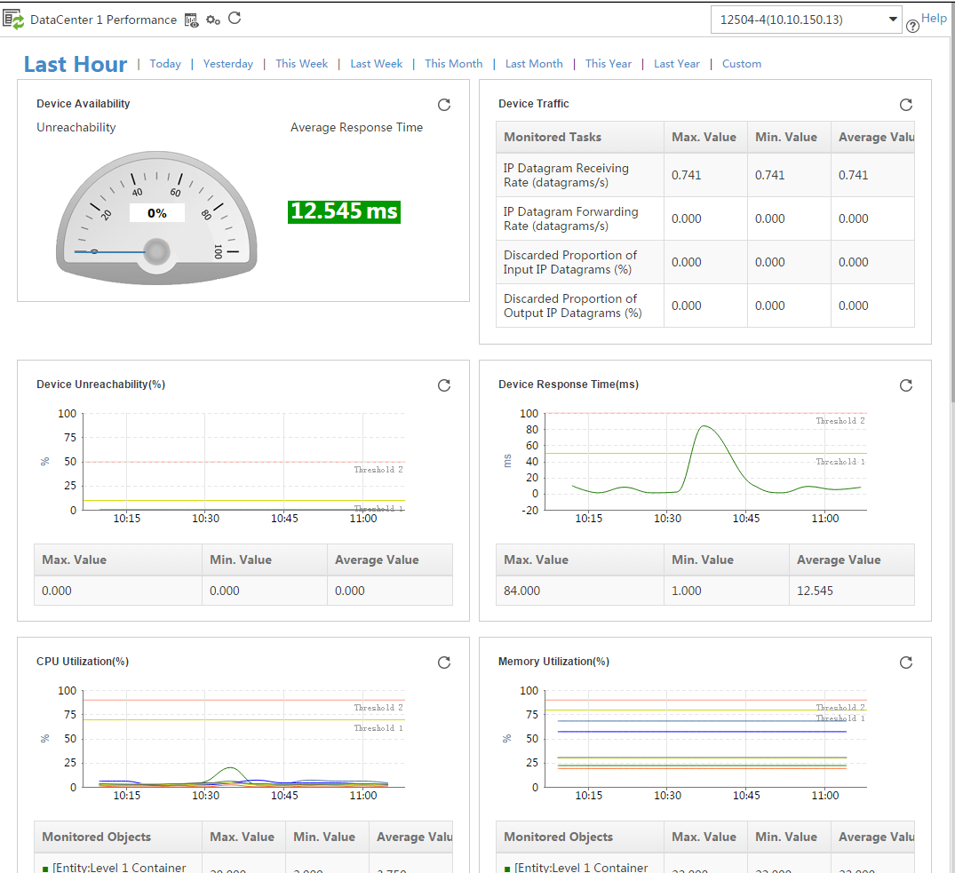
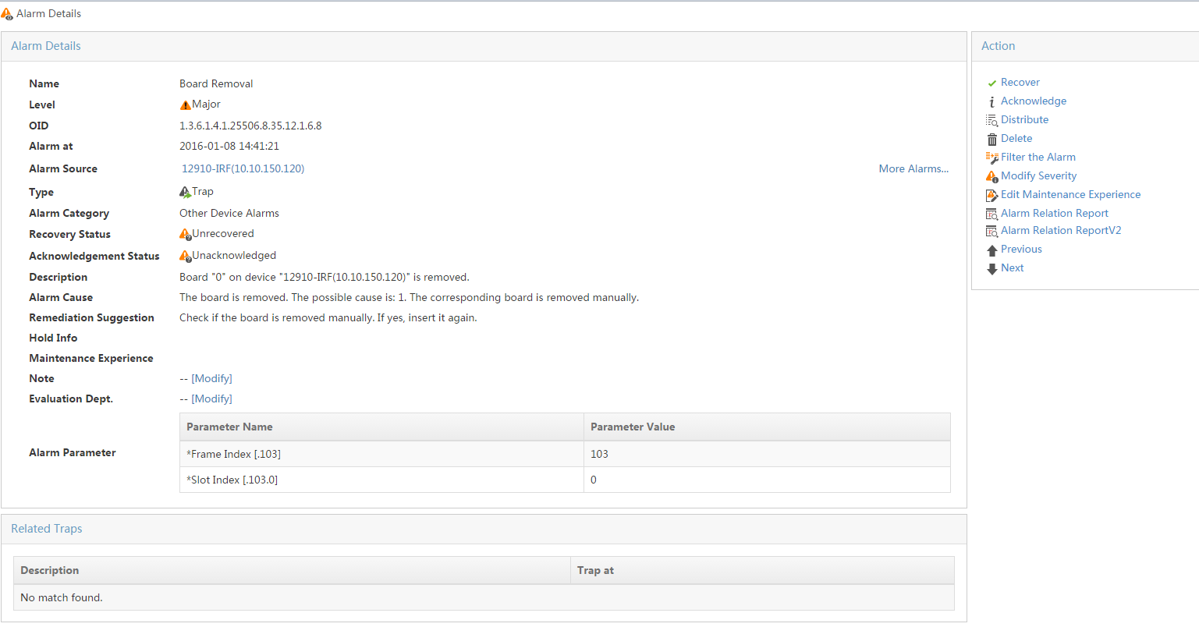
Managing DC using base platform features
Monitoring your DC network
Performance monitoring (bandwidth, cpu …) → Proactive
Alarms (SNMP traps, Syslog messages and internal alarms) → efficient (easily detect issues and fix it)
Follow the global health of your network using devices status

Slide 11
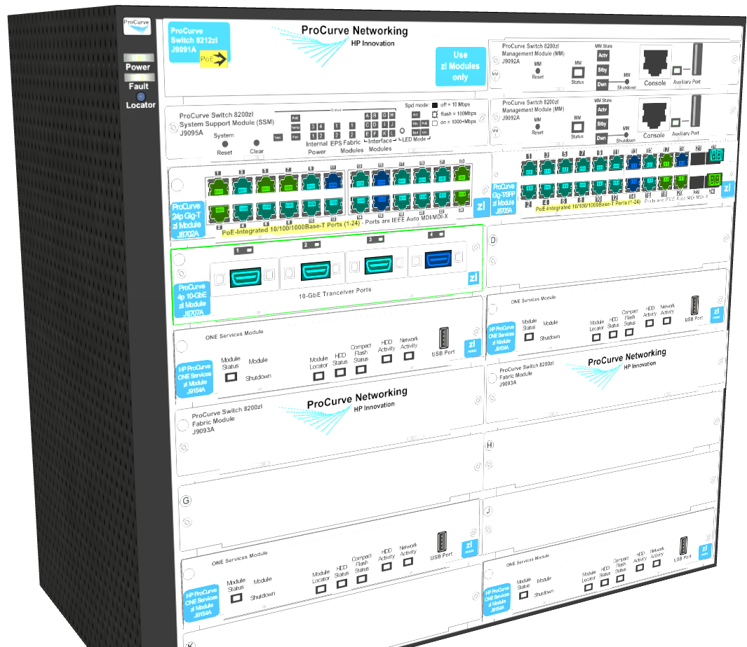
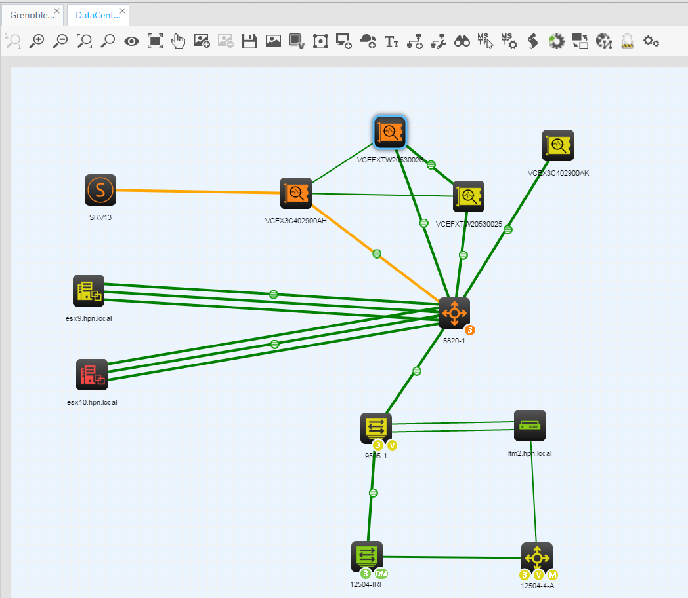
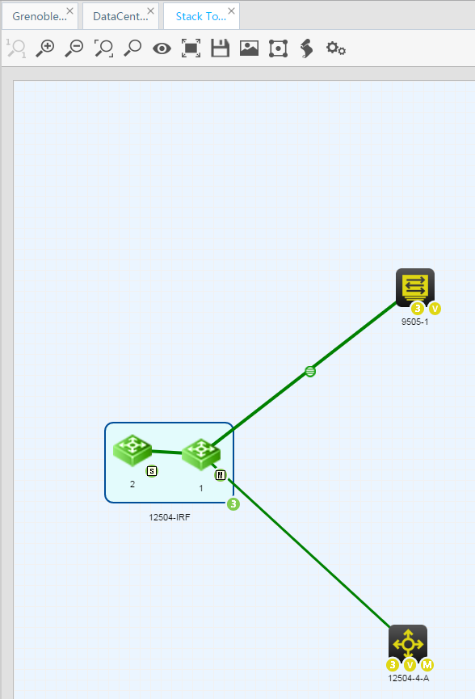
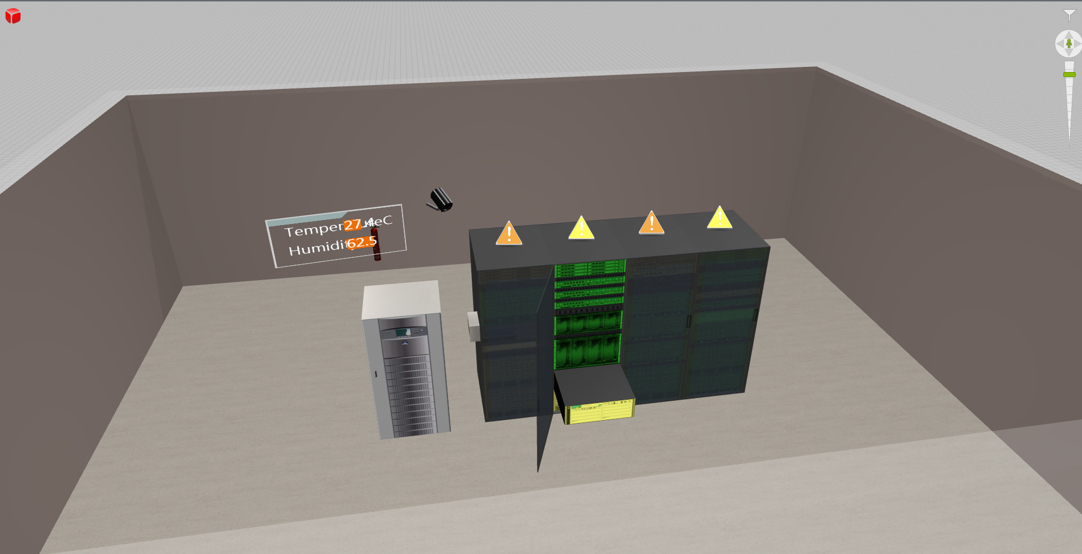
Managing DC using base platform features
Topologies make your network more real …
Layer 2 topologies → view how really your devices are interconnected, analyse path, customize …
Stack topologies → Dive into your stack to see physically interconnections
DC topologies → build your DC and find quickly your faulty devices

Slide 12
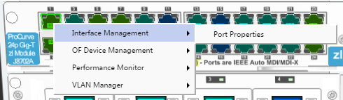
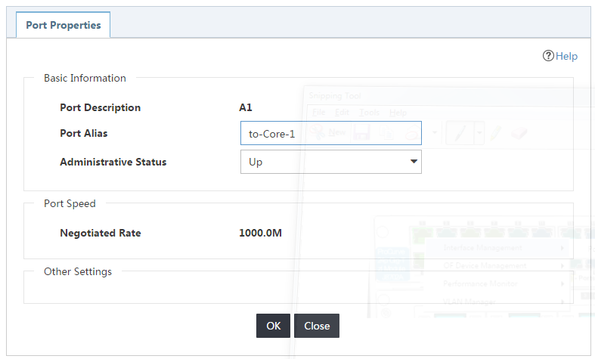
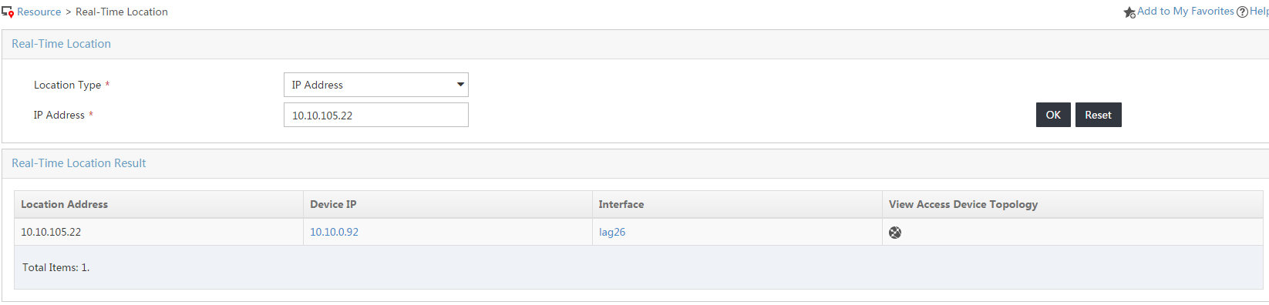
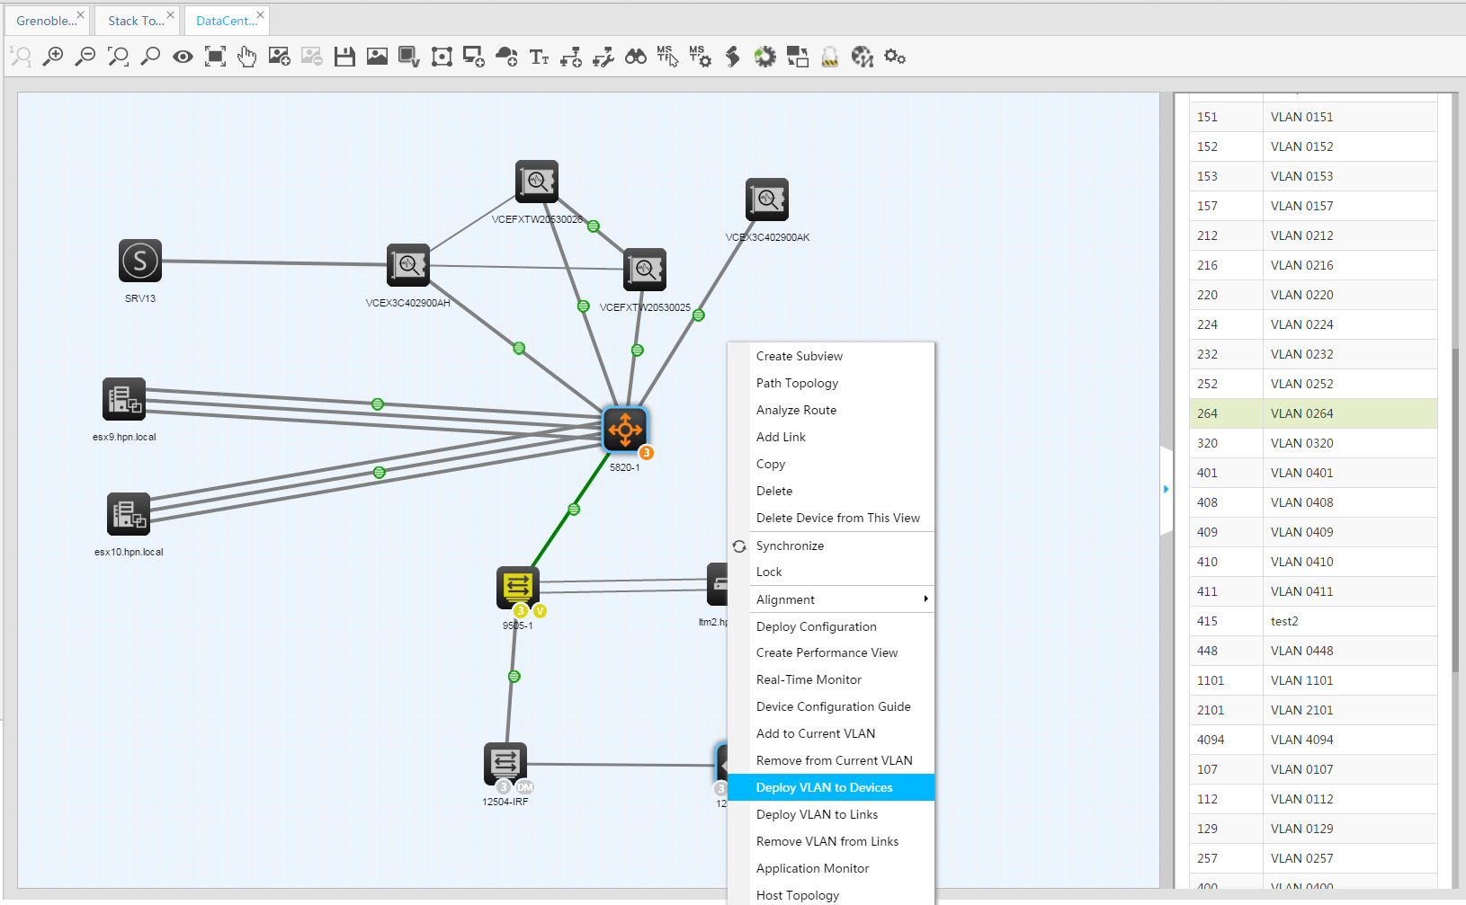
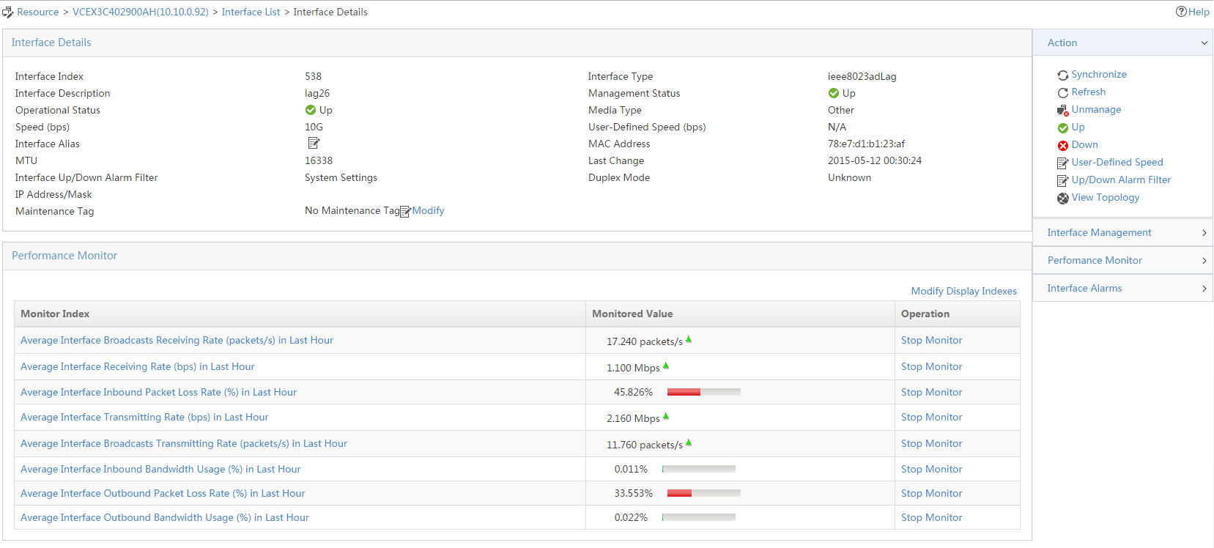
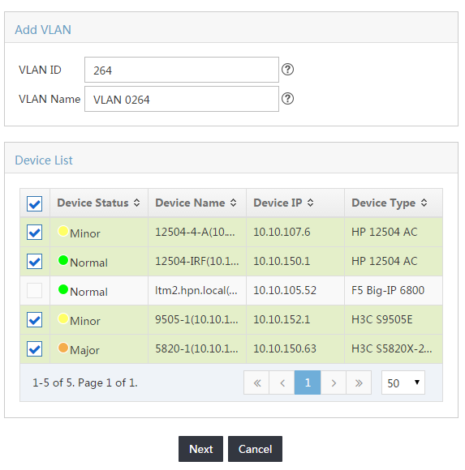
Managing DC using base platform features
Day 2 Day operations
Quickly shutdown / configure a port
Deploy ACL in batches
Manage VLAN on the topology
Locate in real-time ip addresses …

Slide 13
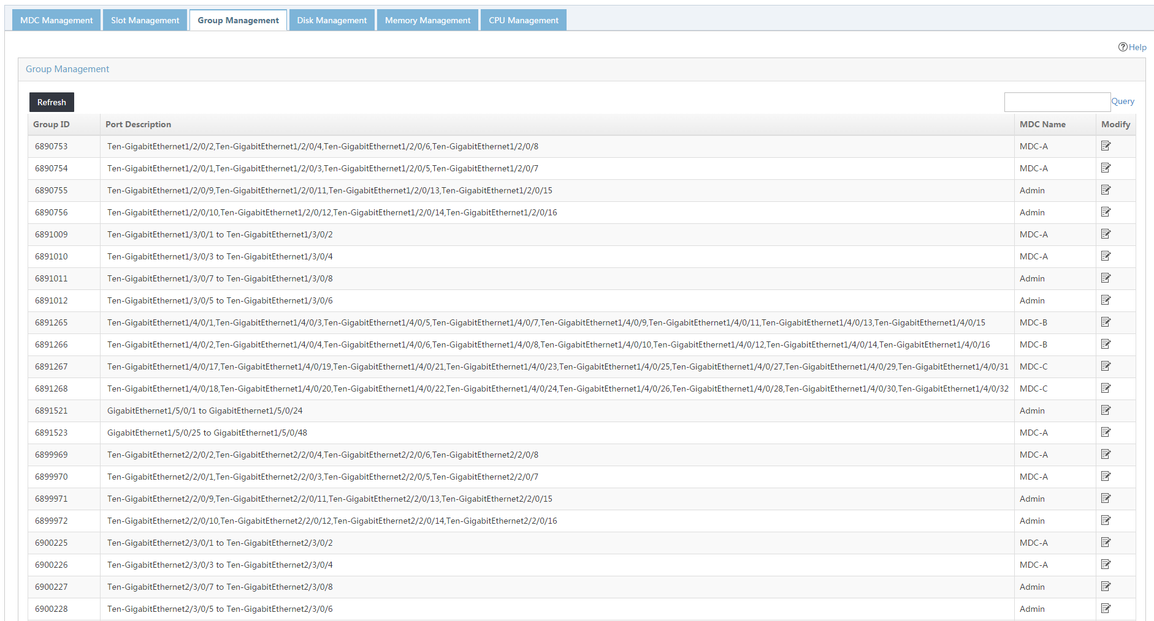
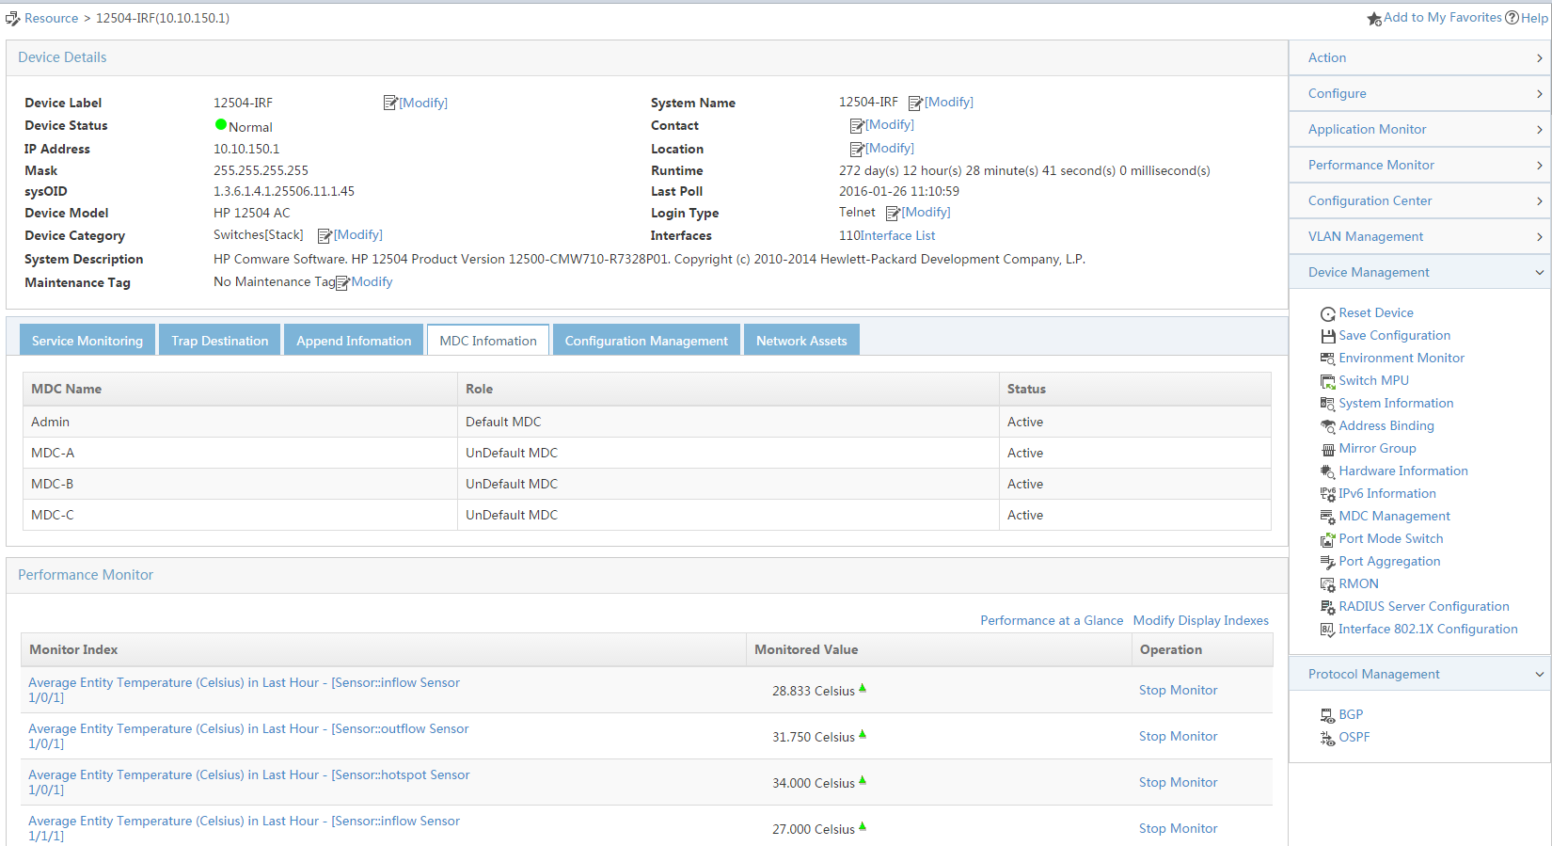
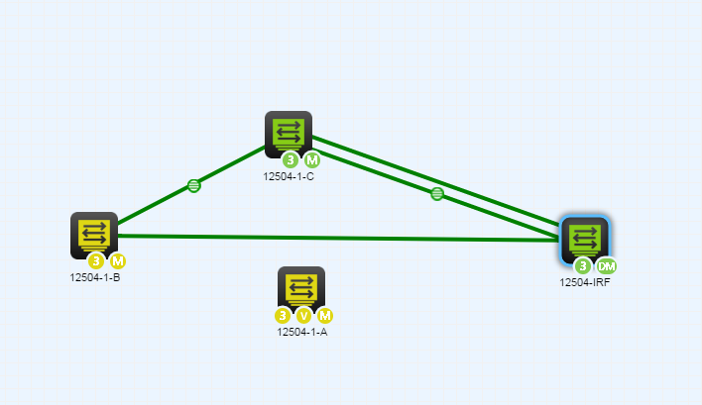
Managing DC using base platform features
Day 2 Day operations (cont)
Monitor / Manage your MDCs

Slide 14
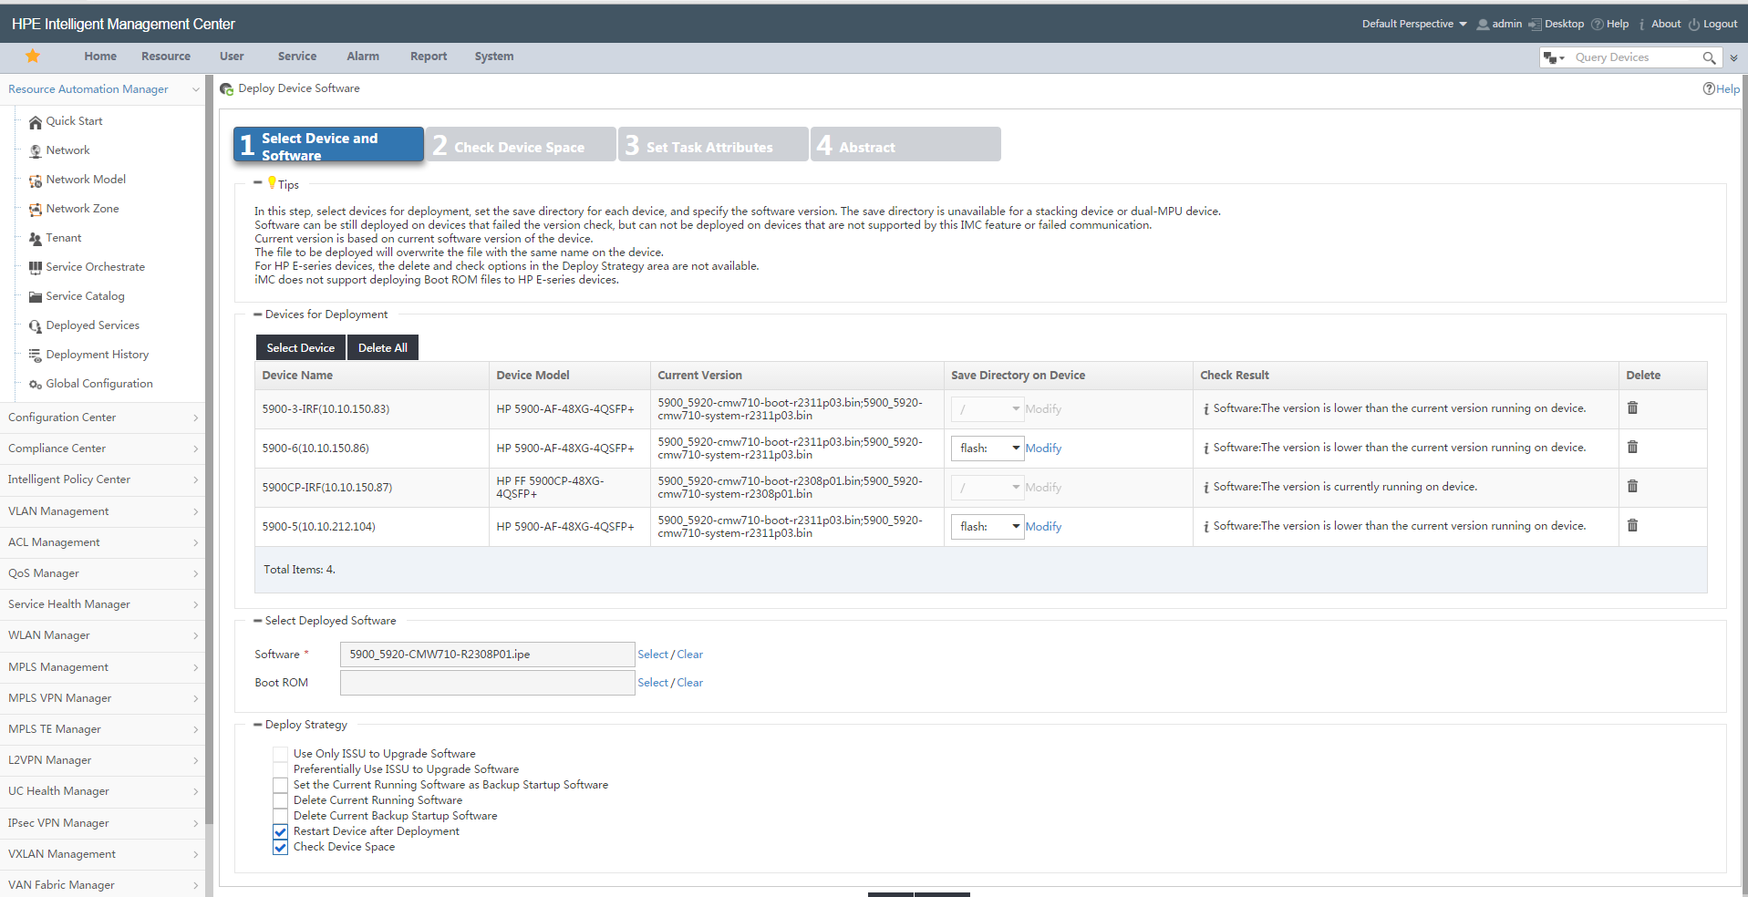
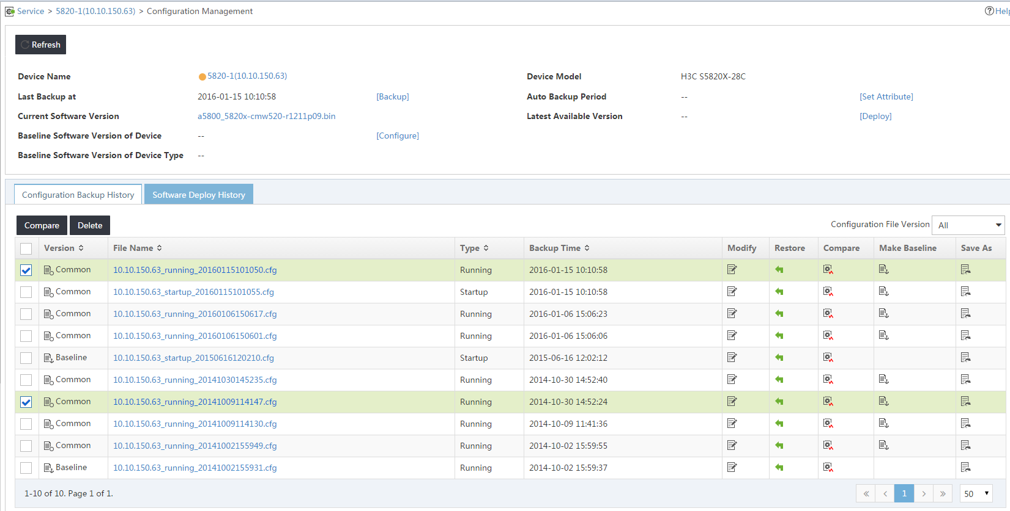
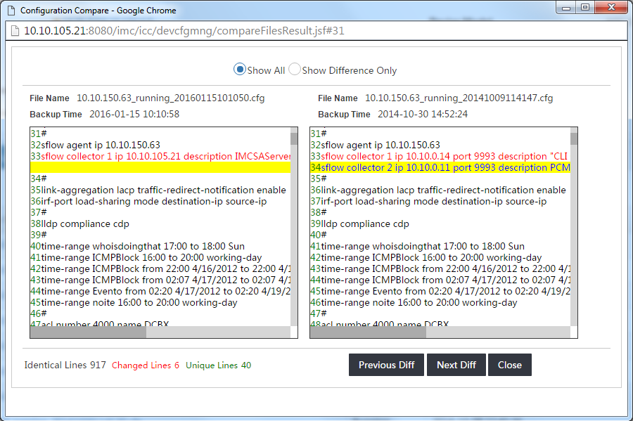
Managing DC using base platform features
Manage Configurations & Firmwares
Backup / restore ; historization ; compare
Configuration templates → batch deploy a change
Compliance check → Check best practices
Bulk deploy new firmwares

Slide 15
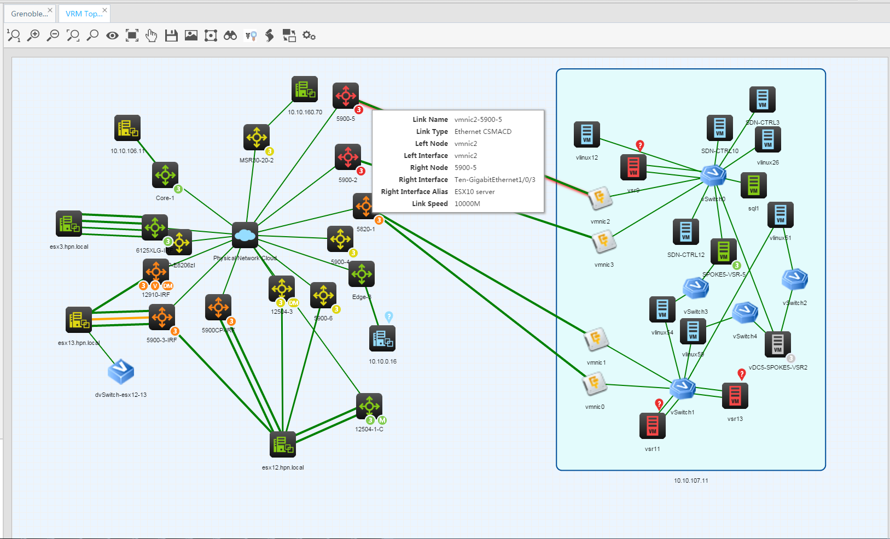
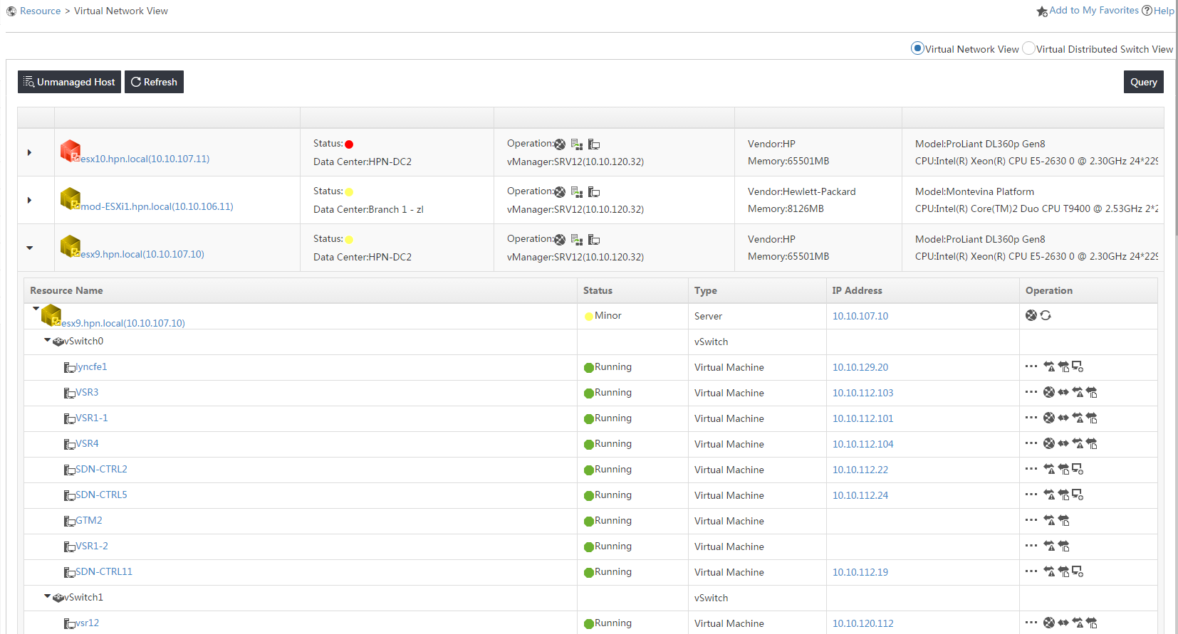
Managing DC using base platform features
Virtual Environment
View your entire virtual world and see how it is connected to real one
Manage your standard and distributed Vswitch
Performance monitoring of both Vservers and VMs
Take action on your virtual environment: shutdown / reboot VM, clone, browse datastore …

Slide 16
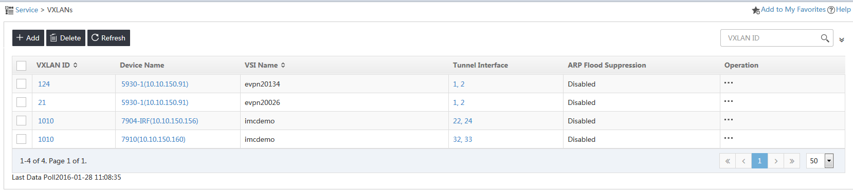
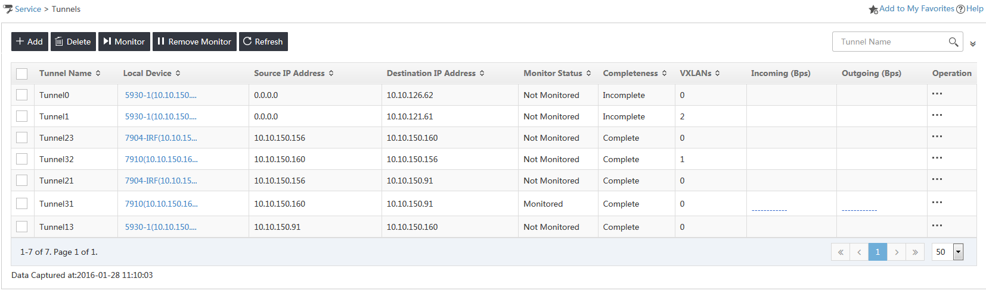
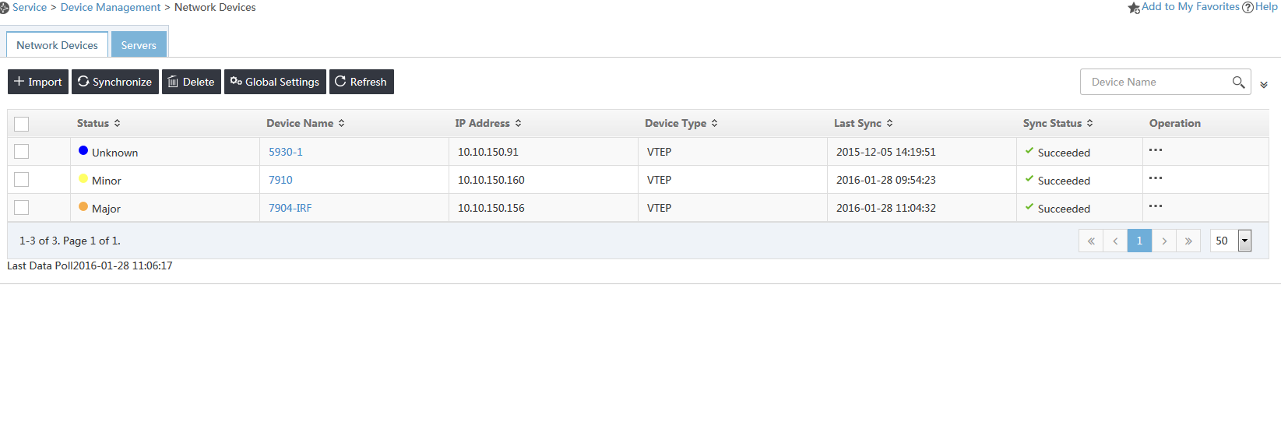
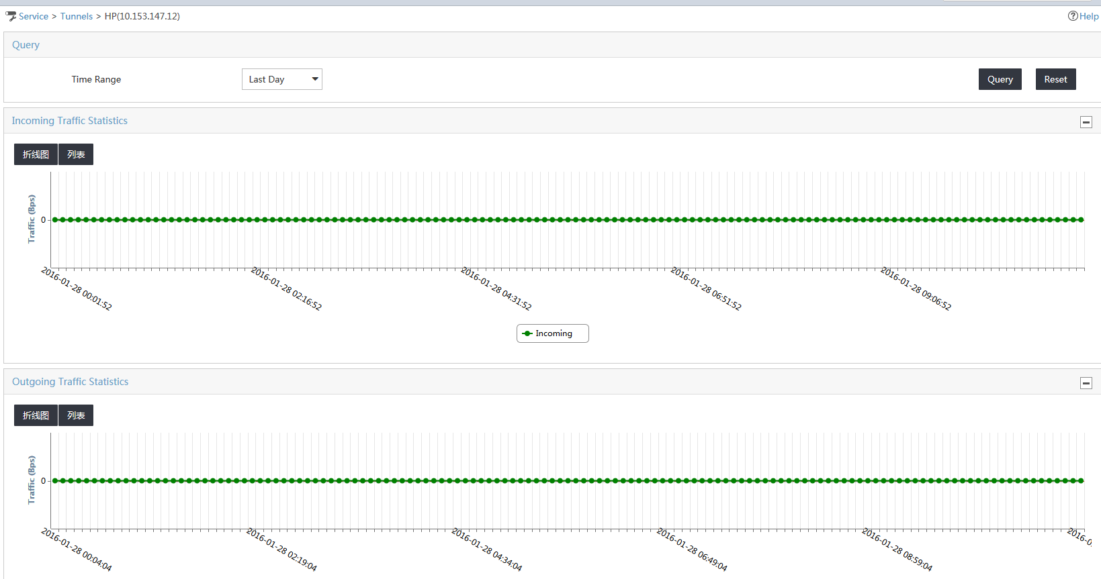
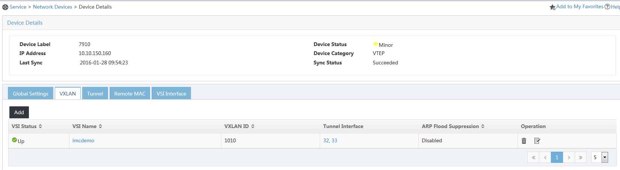
Managing DC using base platform features
NEW in 7.2
VXLAN Phase 1
Show / modify VXLAN devices configuration
List VXLANs view details
List tunnels, show traffic and view details

Slide 17
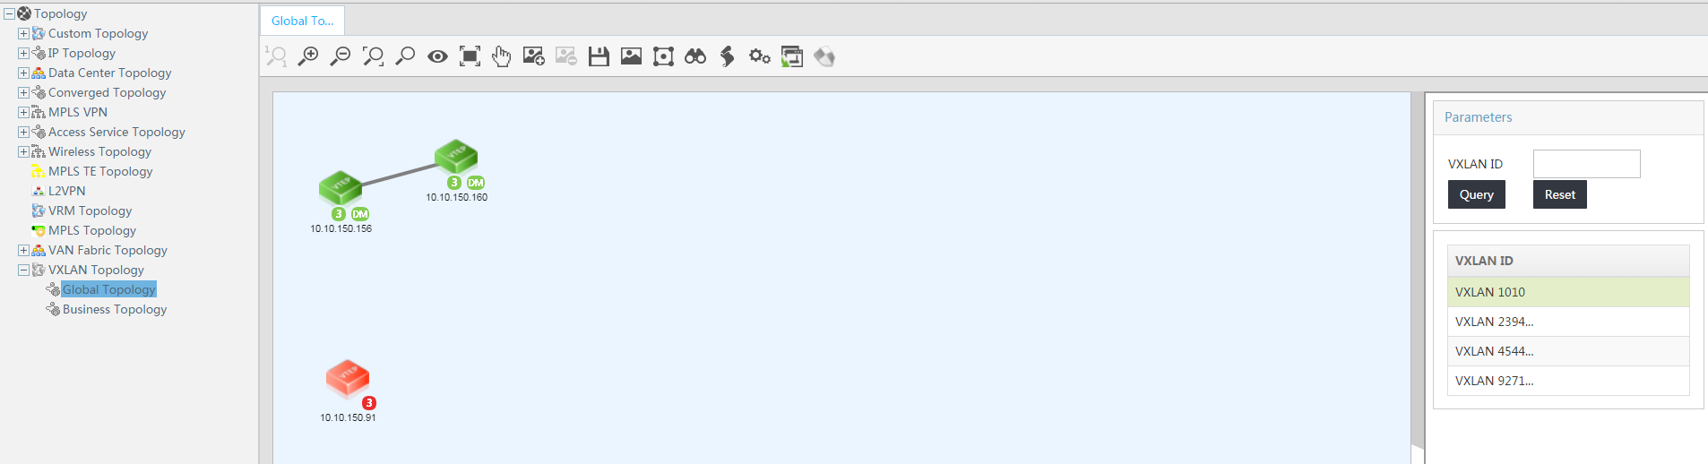
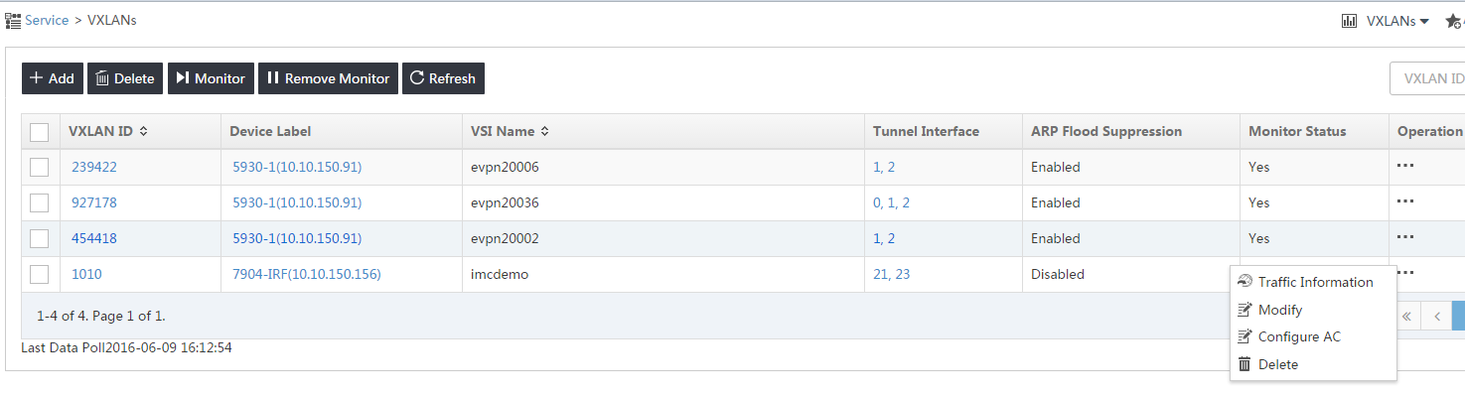
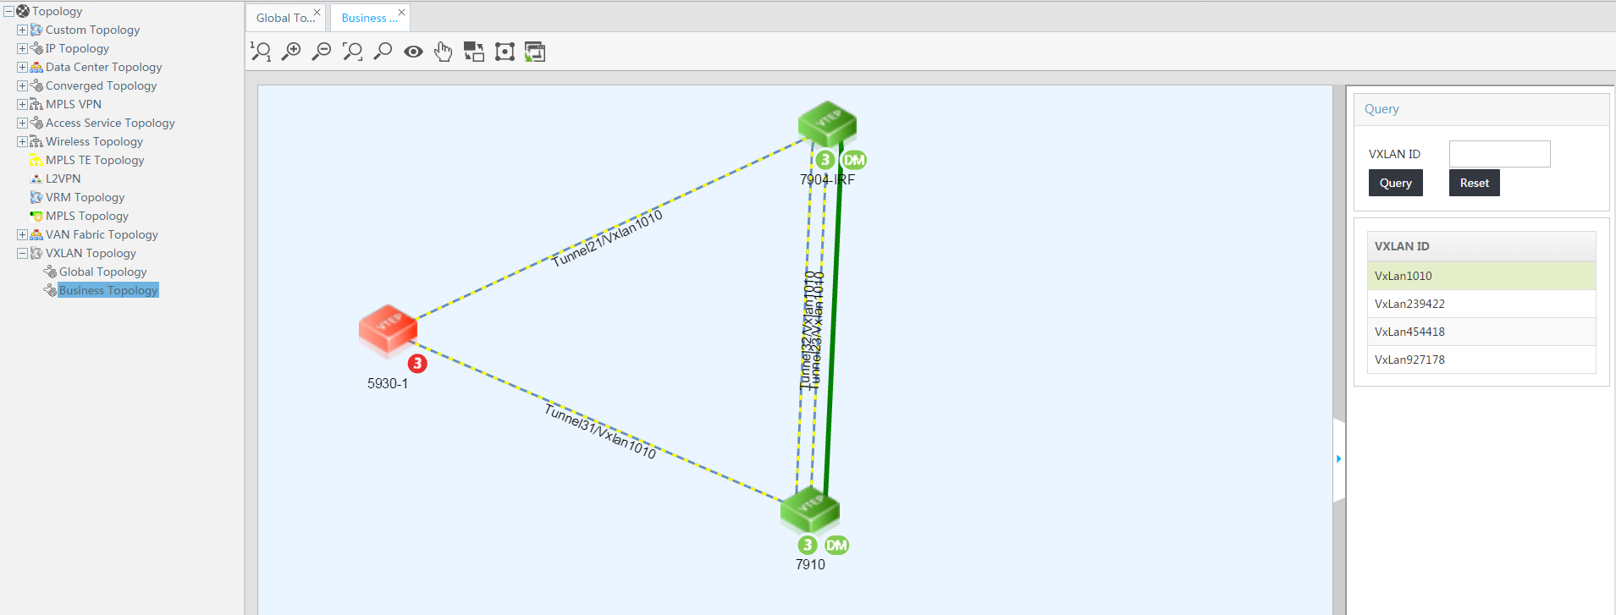
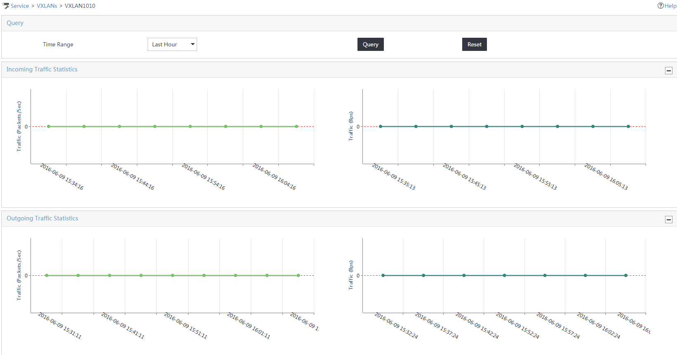
Managing DC using base platform features
NEW in 7.2
P04
VXLAN Phase 2
VXLAN topologies
VXLAN monitoring

Slide 18
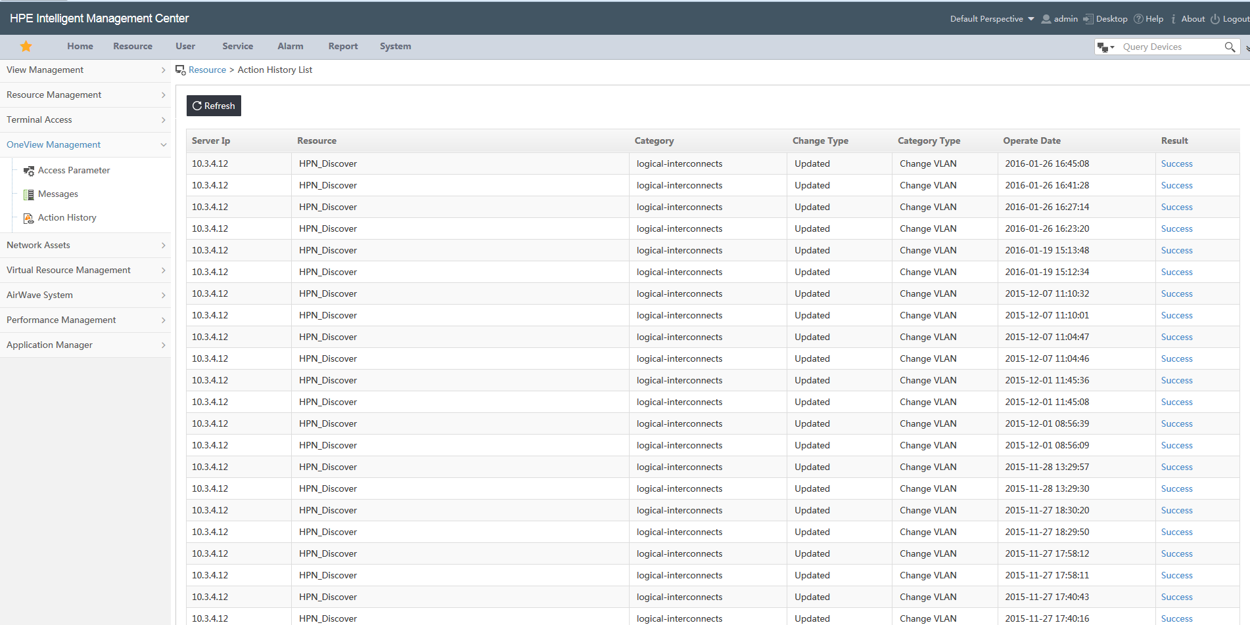
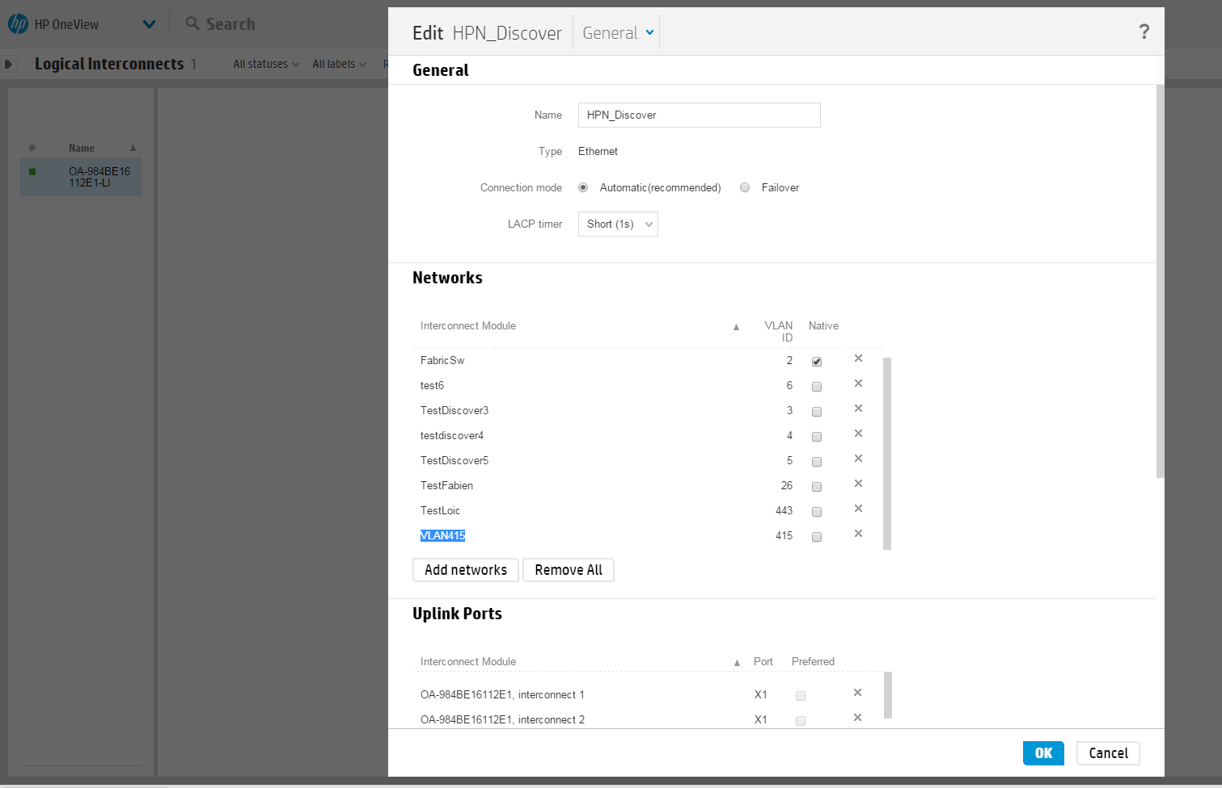
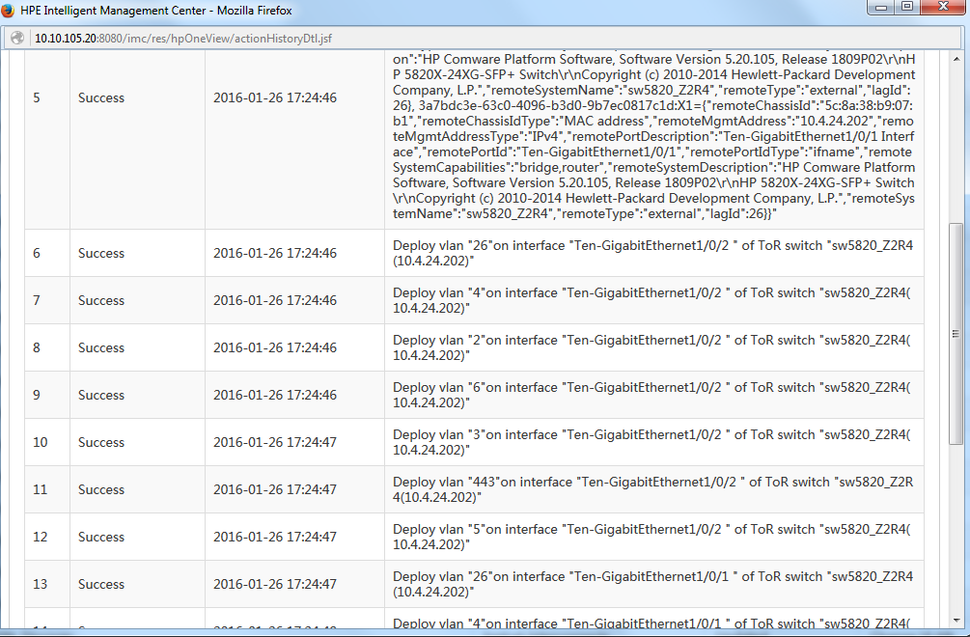
Managing DC using base platform features
NEW in 7.2
OneView integration
Use APIs in order to detect change on Interconnects network configuration in OneView
Find links between Interconnects and switch
Configure corresponding VLAN on switch interfaces
OneView 3.0 support
NEW in last patch

Slide 19
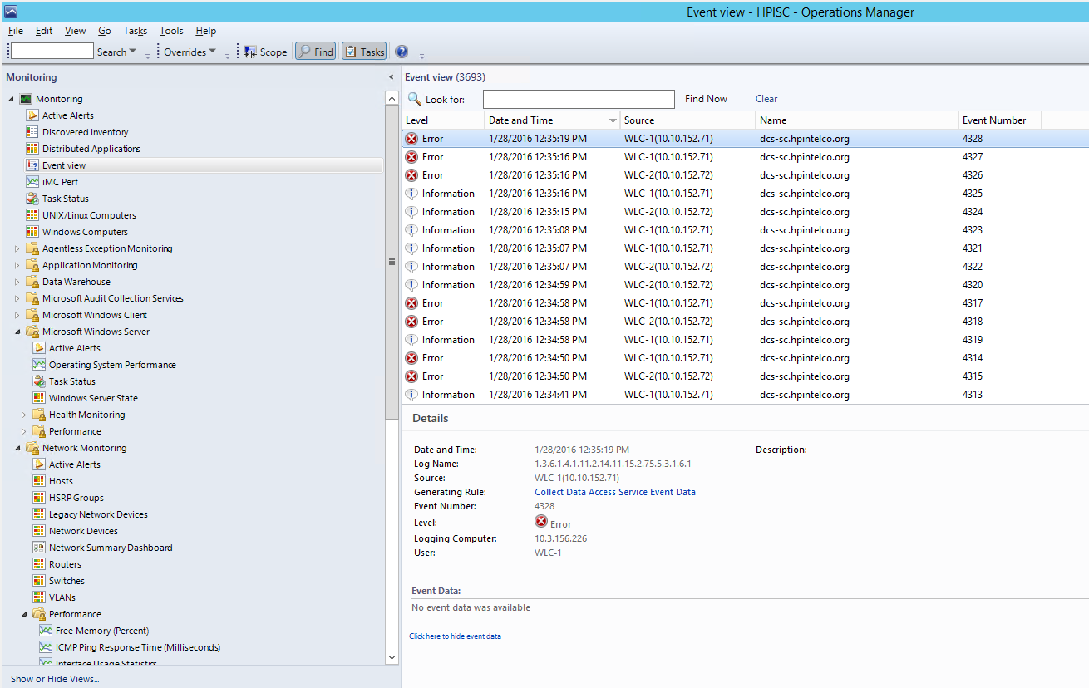
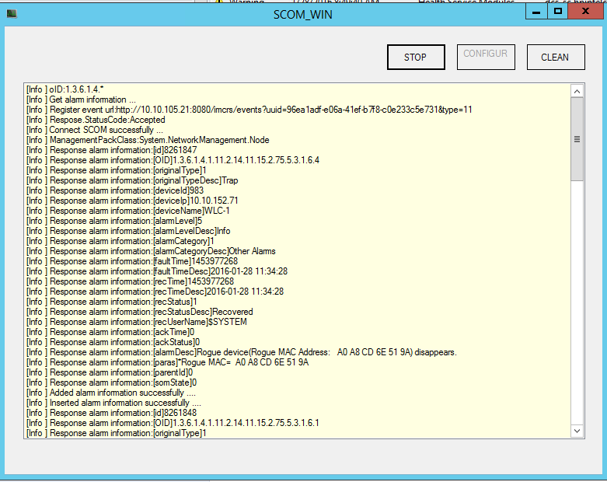
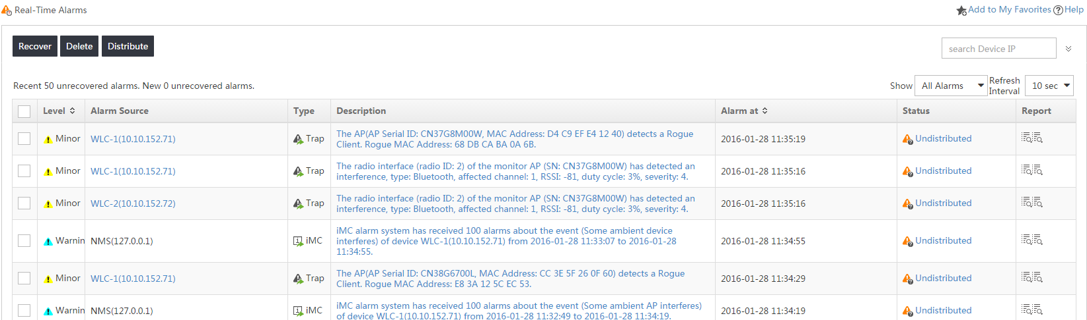
Managing DC using base platform features
SCOM integration
Plugin to install on SCOM server
Directly plugged to iMC alarm bus through eAPI
Write filtered iMC alarm in SCOM events
Use HTTP or
HTTPS
NEW in last patch

Slide 20
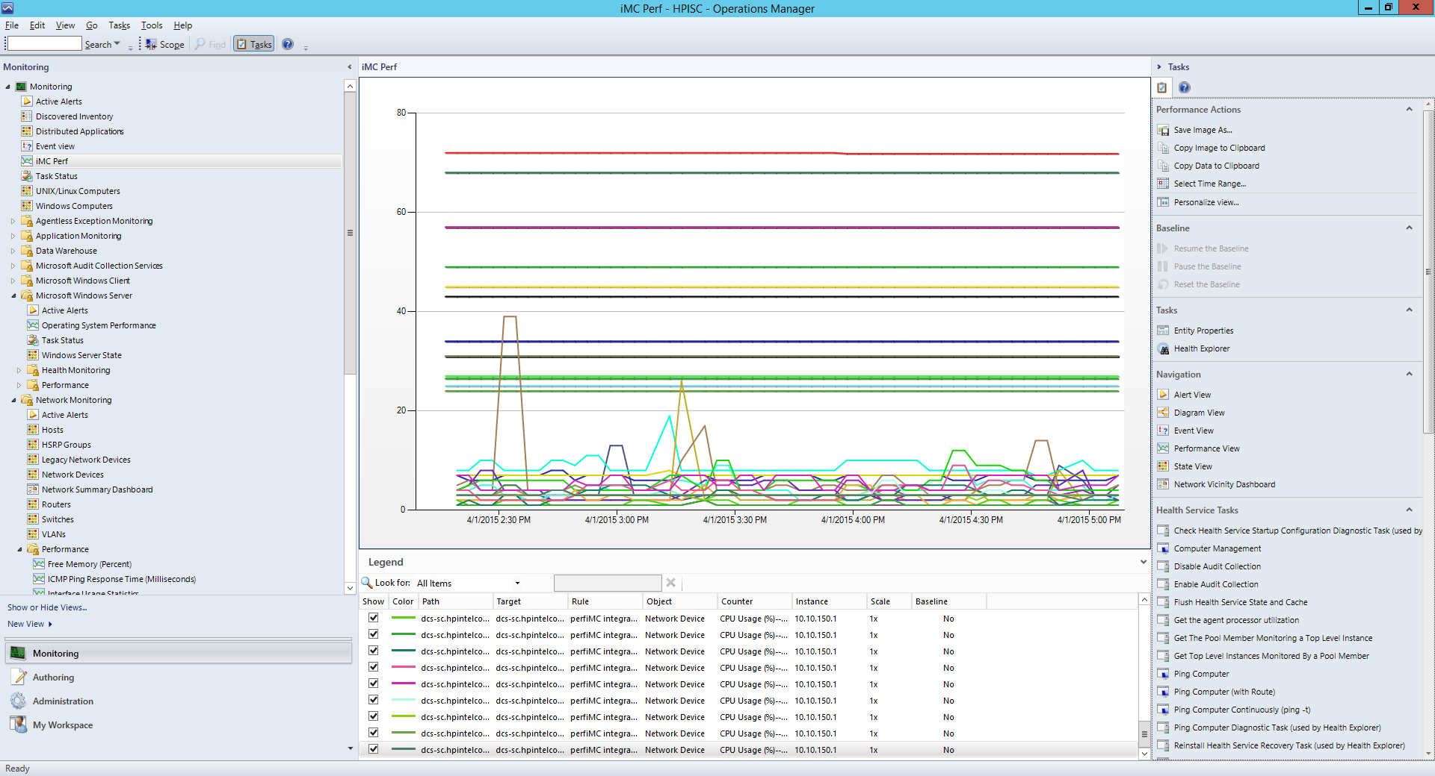
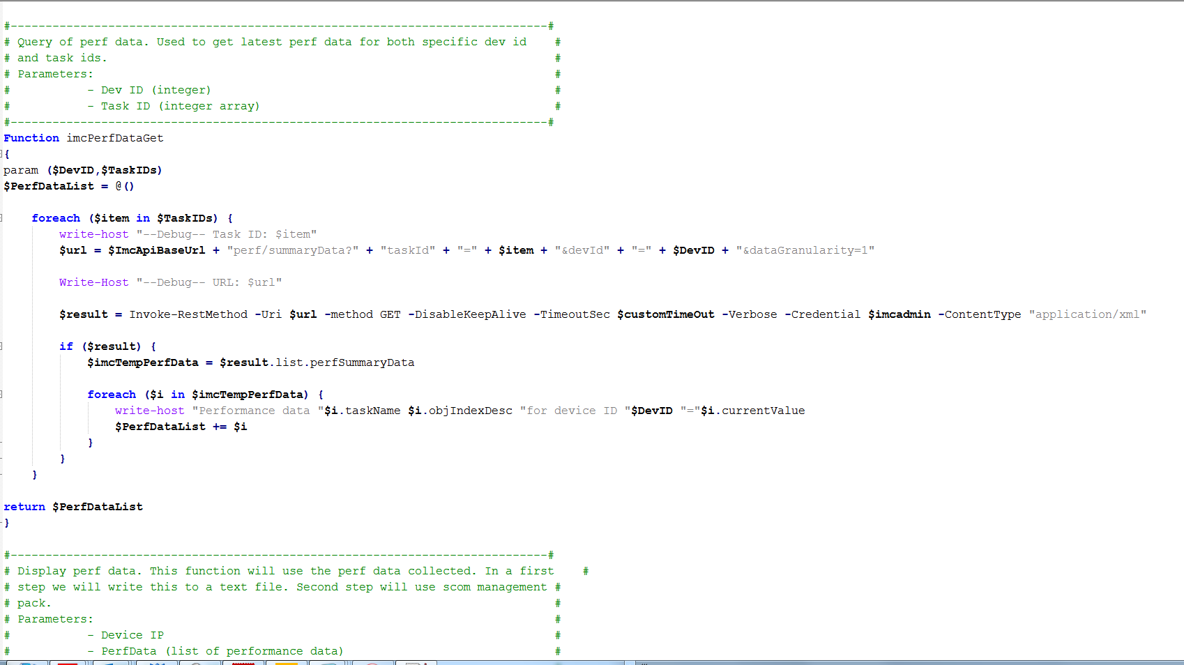
Managing DC using base platform features
Wants to learn more ?
Watch ABC Networking video and visit Airheads Technical Blogs
eAPI
Leverage iMC to external tools
Enhance integrations (snapshot example: enhanced SCOM integration)
Write your own UI
Infinite possibilities … ☺
Import in SCOM as Management Pack

Slide 21
Agenda
Managing DC using base platform features
Monitoring: alarms, status, performance …
Topologies
Day 2 Day operations
Manage configurations & firmwares
Virtual Environment
VXLAN
OneView integration
SCOM integration
eAPI (example with SCOM enhance integration)
Additional modules for DC
NTA
SHM
APM / BSP
VAN Connection Manager
VAN RAM
VAN SDNM
VAN Fabric Manager
Live Demo of main points

Slide 22
Additional Modules for DC

Slide 23
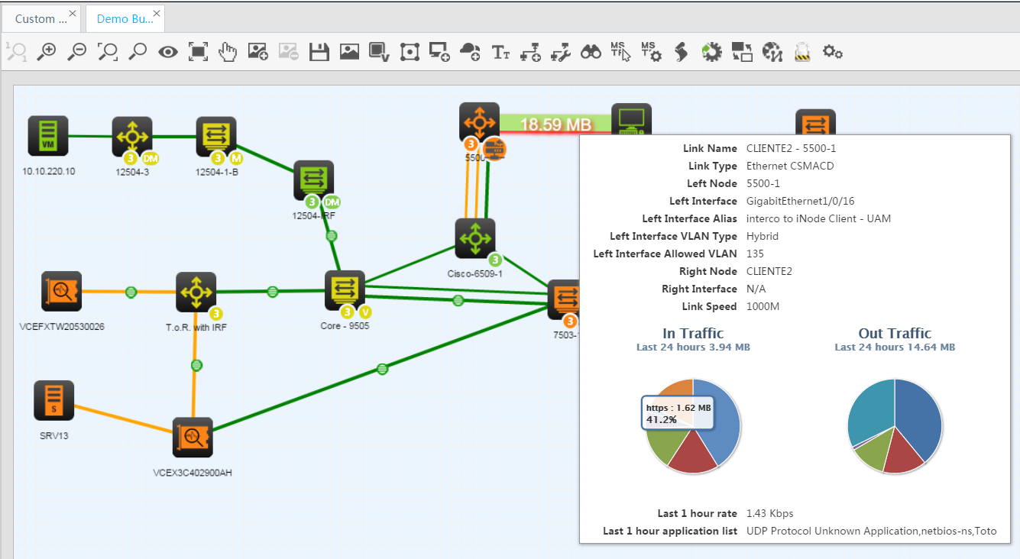
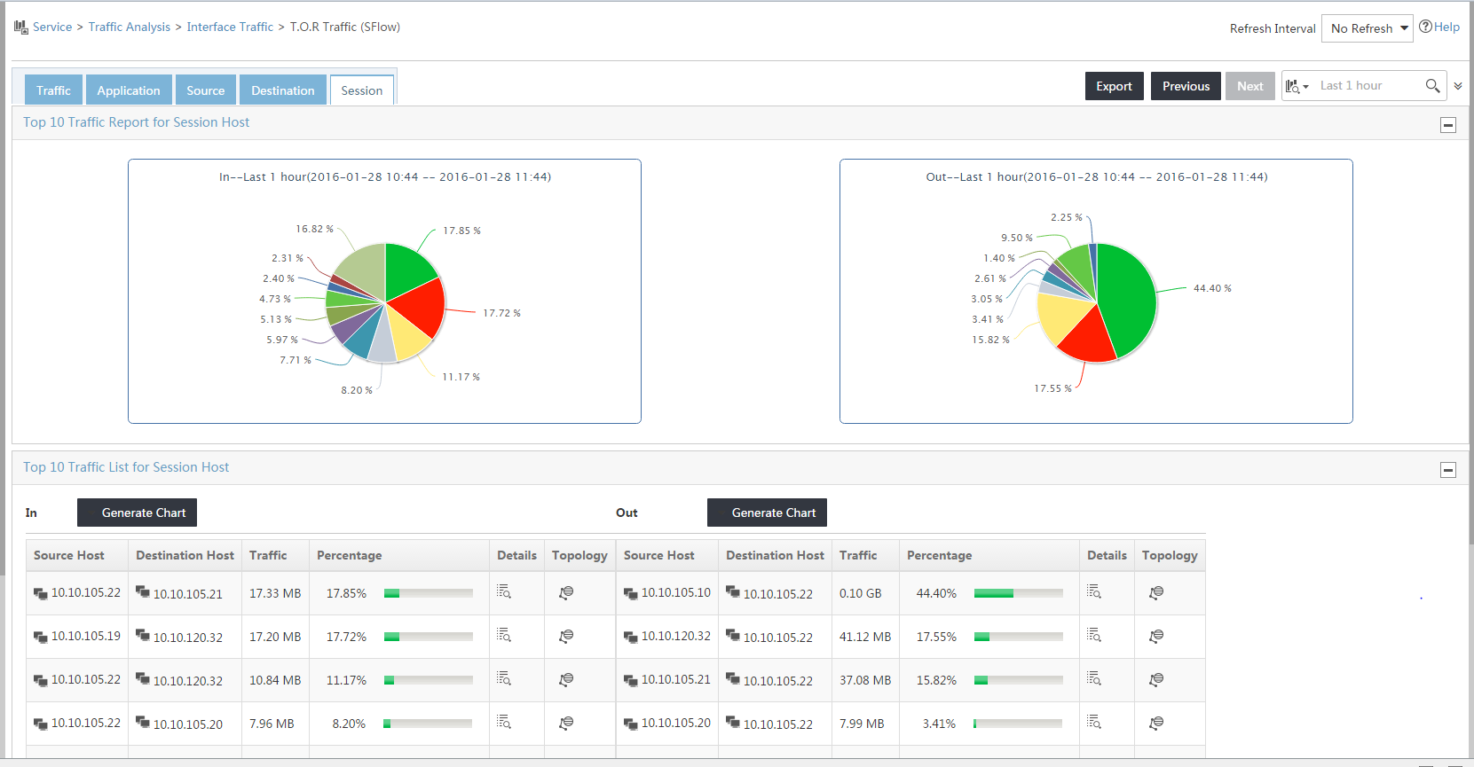
Additional Modules for DC
NTA
View detailed traffic on any Sflow / Netstream / NetFlow device
Predefined / custom Applications details
Top Talkers

Slide 24
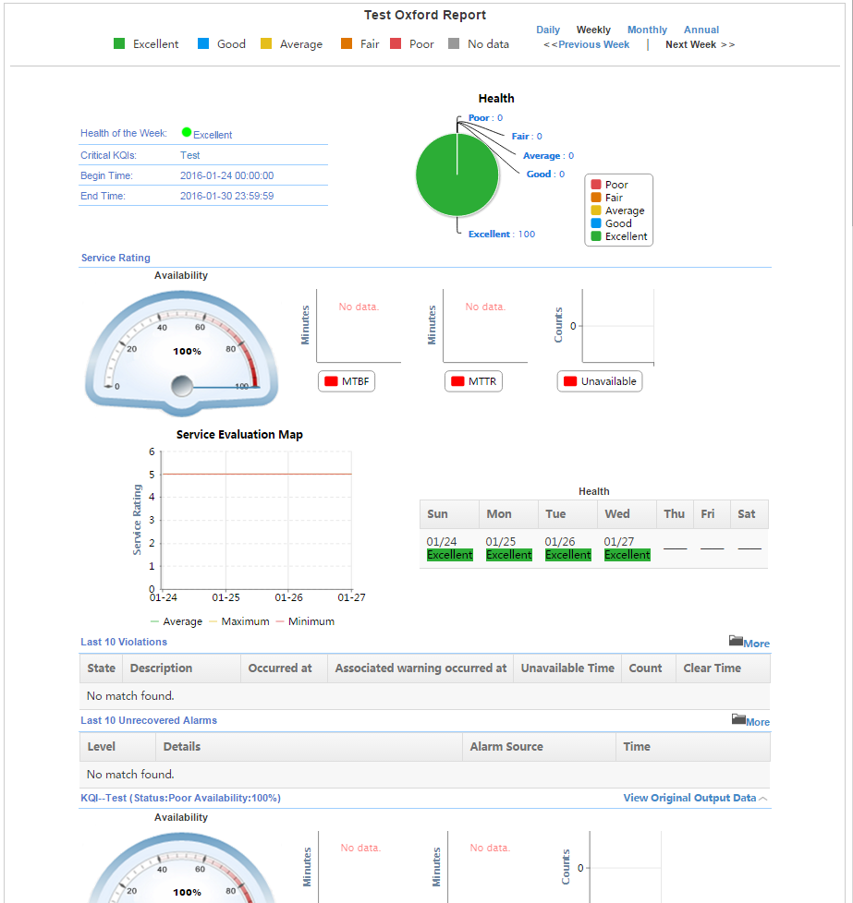
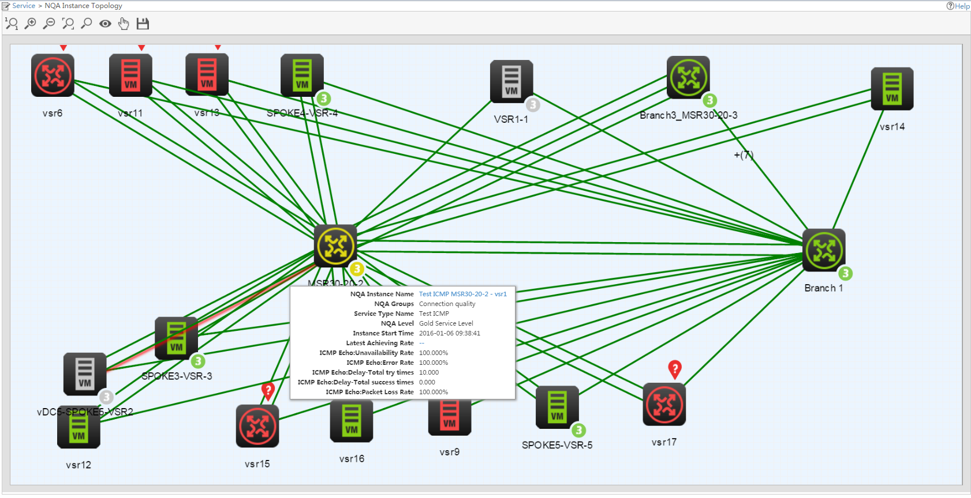
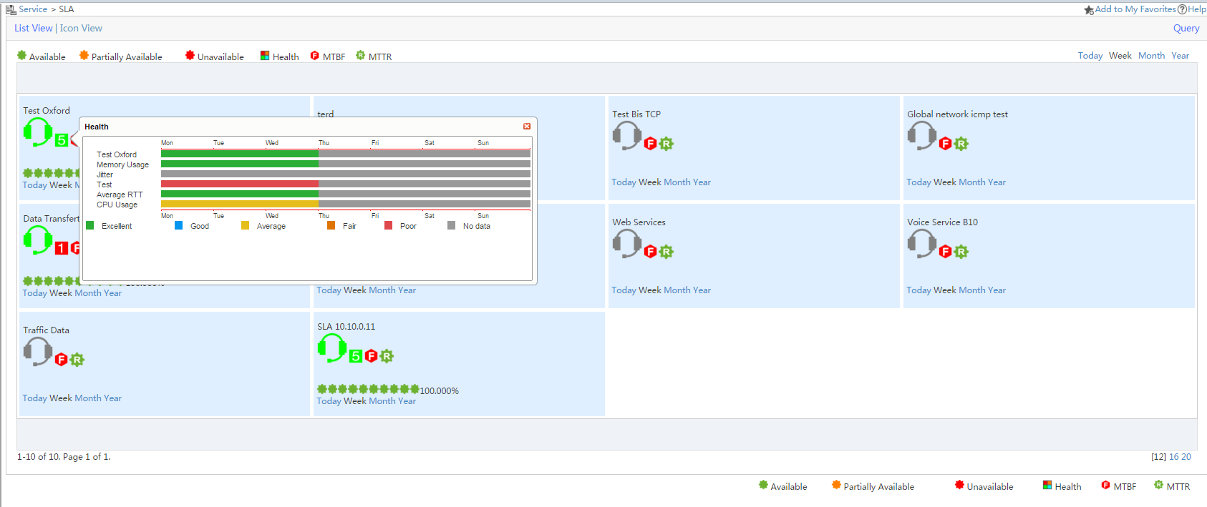
Additional Modules for DC
SHM
Define your own SLA (based on your DC application, servers, network devices …)
Make point to point test using NQA / IPSLA (RTT, Jitter, MOS …)
Test your server connectivity using NQA / IPSLA
Define / combine your own KPIs

Slide 25
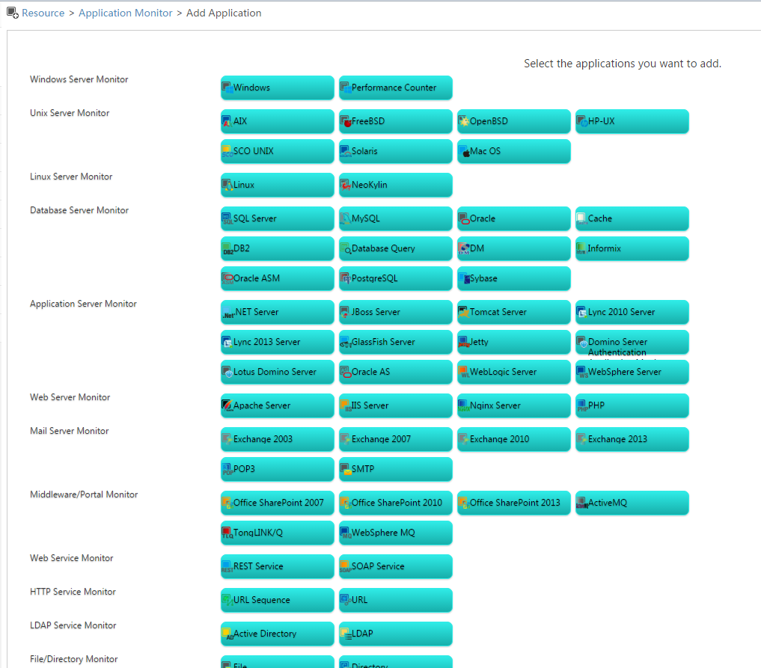
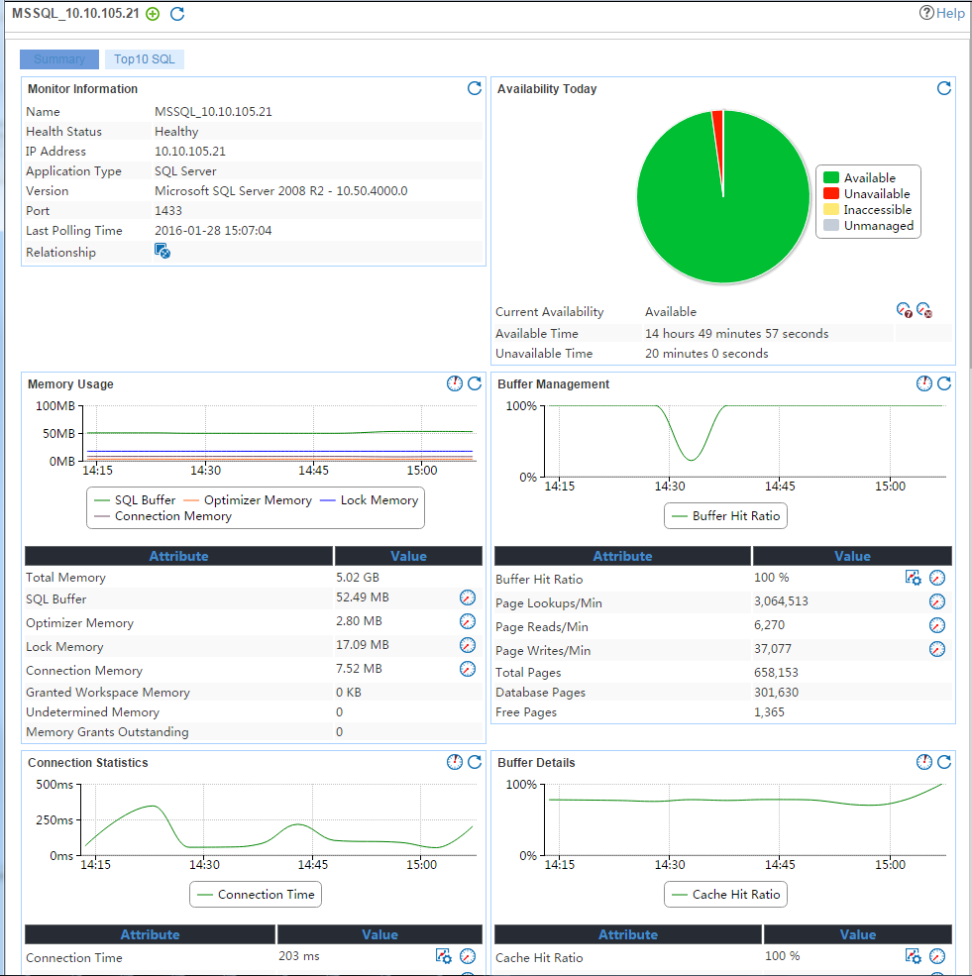
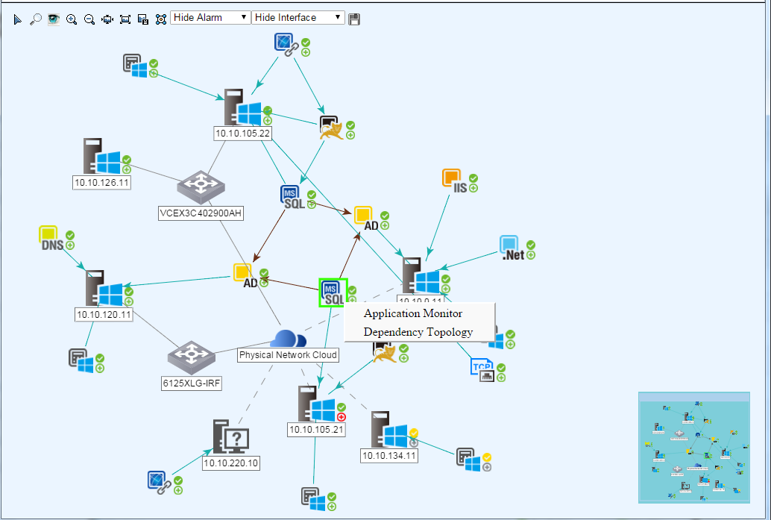
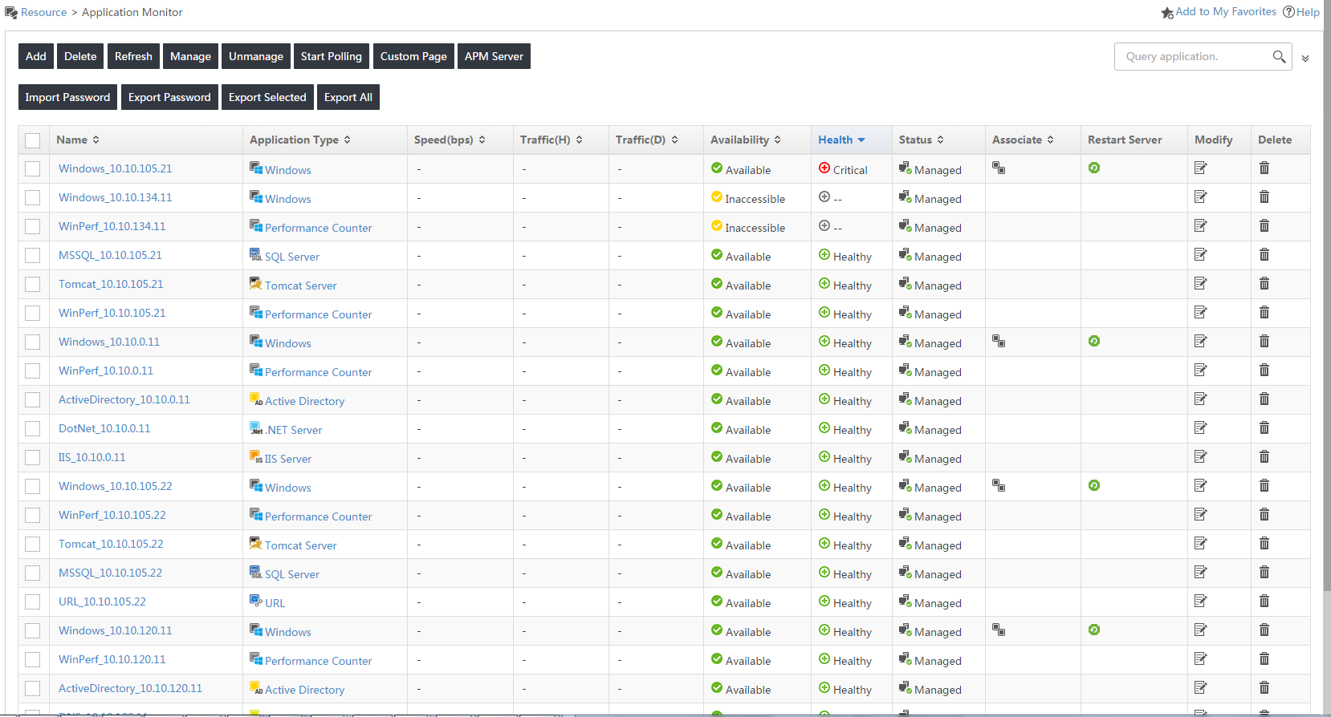
Additional Modules for DC
APM / BSP
APM : add your DC application monitoring in iMC
More and more application supported in each update:
OS monitoring (Windows, Linux, UNIX …)
Database (Oracle, SQL, MySQL …)
Application Servers (JBOSS, Lync, .Net …)
Mail servers (Exchange, SMTP …)
Storage (MSA, OceanStor, Storwize …)

Slide 26
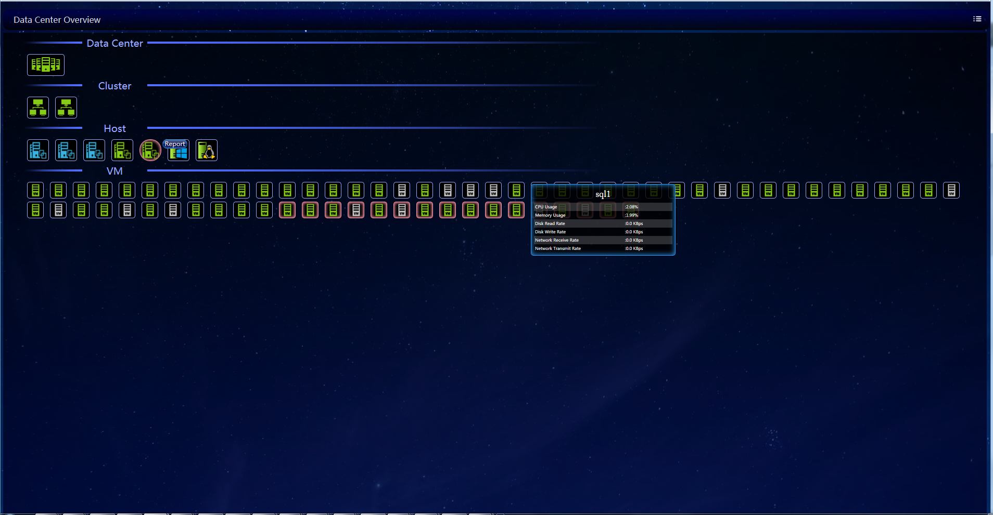
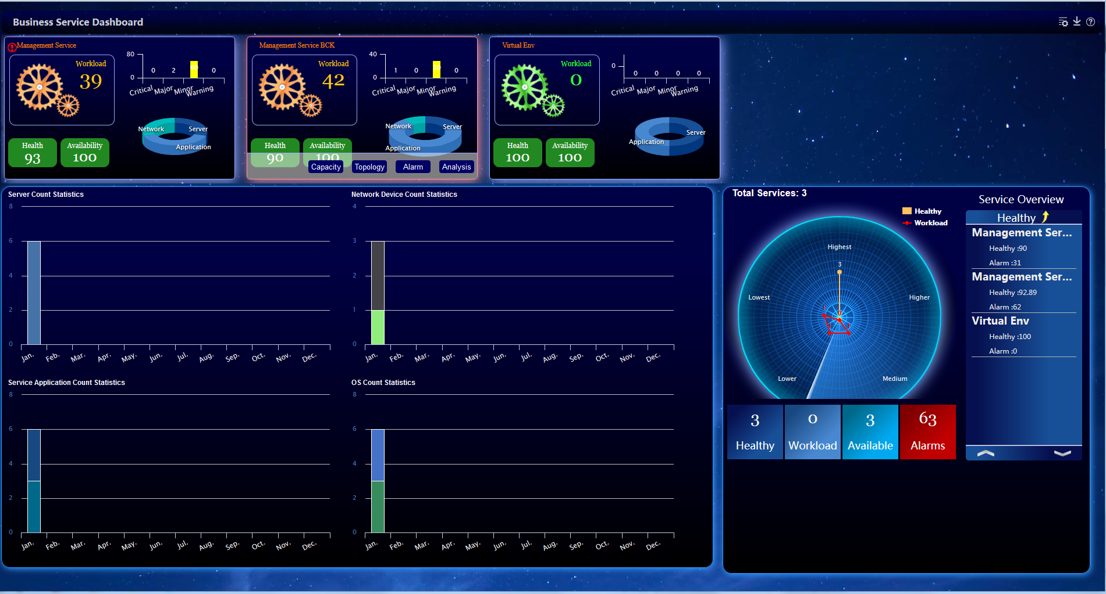
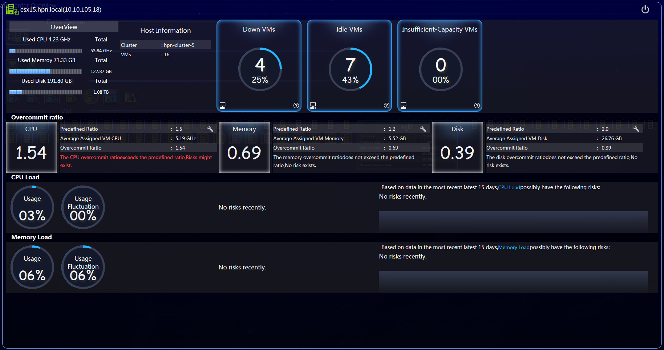
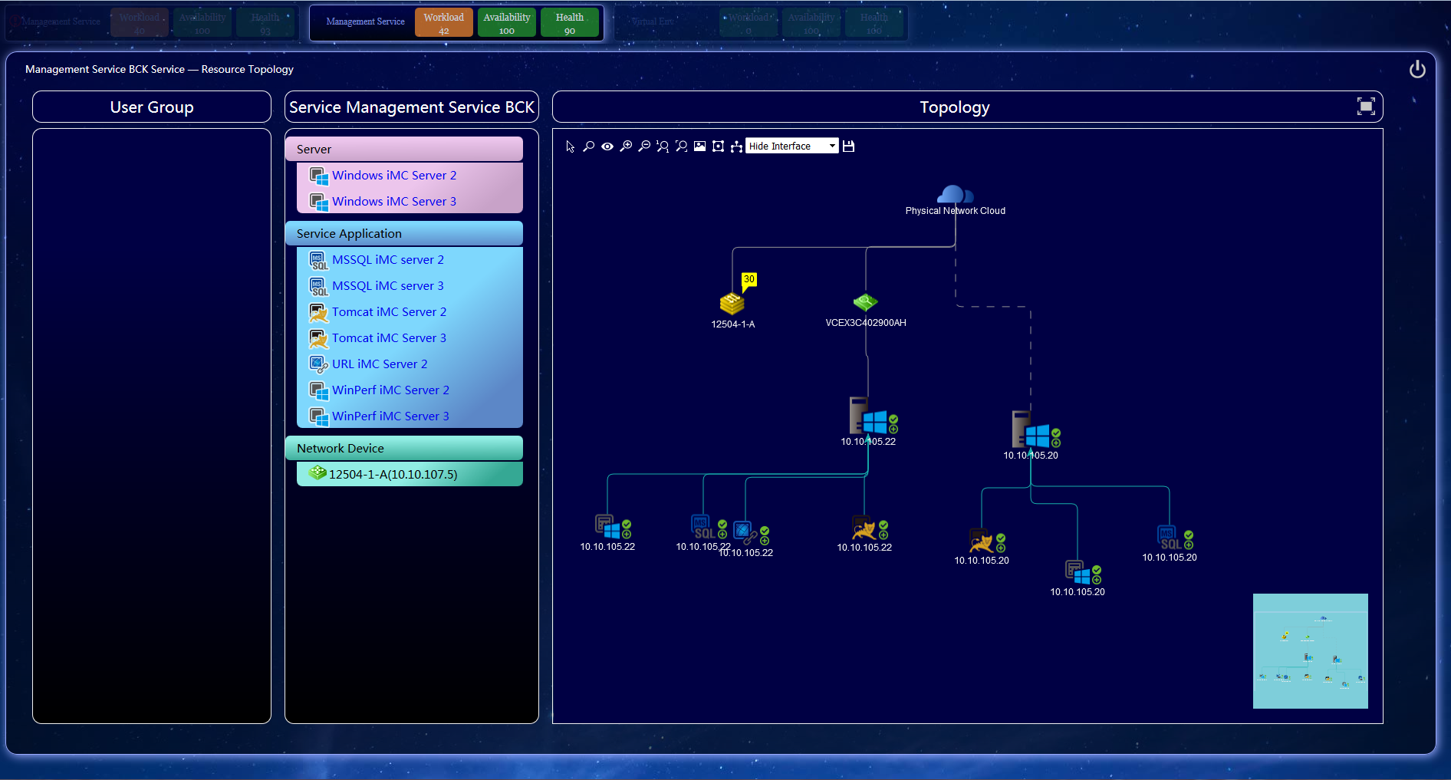
Additional Modules for DC
NEW in 7.2
APM / BSP (con’t)
BSP : combine application – server – Network monitoring to quickly identify bottlenecks
Fast view of service health in Service Dashboard
Drill down to service detailed monitoring
End-to-end topology (easy view of issue impacts)
DC Dashboard (physical servers, virtual servers, Cluster, VM ..)

Slide 27





Additional Modules for DC
Result
VAN Connection Manager
Enhance Virtual Infra management
Automate Network deployment of VM
Define / Manage Network Profiles (VSI) in iMC
Add to VMs / deploy directly in Virtuel Hypervisor
Profile follow the VMs
1.
2.

Slide 28




Additional Modules for DC
VAN RAM
End-to-end orchestration
Define network services (switch / routers conf, Firewall rules, Loadbalancers, deploy / configure VMs …)
Associate network services to tenants
Deployment simulation

Slide 29



Additional Modules for DC
VAN SDNM
Manage OpenFlow Controllers (statistics, conf …)
Visualize OpenFlow tables / rules (and can add entries)
OpenFlow Application repository
OpenFlow Topology

Slide 30

Additional Modules for DC
VAN Fabric Manager
Dedicated DataCenter Module
Unified SPB, TRILL, IRF fabric management
Manages across geographically dispersed locations (DCI/EVI)
VMware vMotion playback
Unified DCB, FCoE converged management

Slide 31






Additional Modules for DC
VAN Fabric Manager - TRILL

Slide 32





Additional Modules for DC
VAN Fabric Manager - SPB

Slide 33


Additional Modules for DC
VAN Fabric Manager – SPB (Con’t)

Slide 34





Additional Modules for DC
VAN Fabric Manager - EVI

Slide 35





Additional Modules for DC
VAN Fabric Manager – EVI (Con’t)

Slide 36






Additional Modules for DC
VAN Fabric Manager - SAN

Slide 37
Agenda
Managing DC using base platform features
Monitoring: alarms, status, performance …
Topologies
Day 2 Day operations
Manage configurations & firmwares
Virtual Environment
VXLAN
OneView integration
SCOM integration
eAPI (example with SCOM enhance integration)
Additional modules for DC
NTA
SHM
APM / BSP
VAN Connection Manager
VAN RAM
VAN SDNM
VAN Fabric Manager
Live Demo of main points

Slide 38
Live Demonstration
Live demonstration using iMC 7.2 Grenoble Innovation Center Lab

Slide 39


Live Demo

Slide 40
Live Demo
Be aware and react
Be proactive
Manage the changes
Integrate with DC ecosystem
Be able to locate issues
Monitor and Manage specific DC « protocols »
Notes:
1) Alarm and device details, Dashboard (and dc topo)
2) Perf monitor, thresholds, NTA
3) ICC
4) OneView, VCM, VRM, RAM, SCOM and API
5) APM / BSP
6) VFM, VXLAN

Slide 41
Live Demo
Be aware and react
Be proactive
Manage the changes
Integrate with DC ecosystem
Be able to locate issues
Monitor and Manage specific DC « protocols »
Notes:
1) Alarm and device details, dashboard (and dc topo)
2) Perf monitor, thresholds, NTA
3) ICC
4) OneView, VCM, VRM, RAM, SCOM and API
5) APM / BSP
6) VFM, VXLAN

Slide 42
Live Demo
Be aware and react
Be proactive
Manage the changes
Integrate with DC ecosystem
Be able to locate issues
Monitor and Manage specific DC « protocols »
Notes:
1) Alarm and device details (and dc topo)
2) Perf monitor, thresholds, NTA
3) ICC
4) OneView, VCM, VRM, RAM, SCOM and API
5) APM / BSP
6) VFM, VXLAN

Slide 43
Live Demo
Be aware and react
Be proactive
Manage the changes
Integrate with DC ecosystem
Be able to locate issues
Monitor and Manage specific DC « protocols »
Notes:
1) Alarm and device details (and dc topo)
2) Perf monitor, thresholds, NTA
3) ICC
4) OneView, VCM, VRM, RAM, SCOM and API
5) APM / BSP
6) VFM, VXLAN

Slide 44
Live Demo
Be aware and react
Be proactive
Manage the changes
Integrate with DC ecosystem
Be able to locate issues
Monitor and Manage specific DC « protocols »
Notes:
1) Alarm and device details (and dc topo)
2) Perf monitor, thresholds, NTA
3) ICC
4) OneView, VCM, VRM, RAM, SCOM and API
5) APM / BSP
6) VFM, VXLAN

Slide 45
Live Demo
Be aware and react
Be proactive
Manage the changes
Integrate with DC ecosystem
Be able to locate issues
Monitor and Manage specific DC « protocols »
Notes:
1) Alarm and device details (and dc topo)
2) Perf monitor, thresholds, NTA
3) ICC
4) OneView, VCM, VRM, RAM, SCOM and API
5) APM / BSP
6) VFM, VXLAN

Slide 46


What is Airheads Community?
http://community.arubanetworks.com/
Airheads Community is the largest professional community of wired and wireless, security and mobility experts. It’s an interactive online community where you can collaborate with some of the sharpest minds in the networking industry.
46K+ global members
5,000 (8%) EMEA Airheads
Engineer community of : Customers/ Partners/ Employees/ Influencers/ Tech Bloggers
Avg. response time is 18 min
117k forum posts on Wireless Access | Campus Switching| AAA, NAC, Guest Access & BYOD | Network Management (IMC & AirWave)| Aruba Instant & Cloud Wi-Fi | Mobile Engagement| SDN| Data Center
Free 7200 External Reviewed & Approved Solutions| VRDs| Installation Guides| TAC Support Ticket System
Yearly Airheads track during EMEA Atmosphere
Notes:
EMEA Atmosphere - http://www.arubanetworks.com/emeaatmosphere/
Airheads Resource Page- Partners/ Customers: https://arubapedia.arubanetworks.com/afp/index.php/Airheads_Community
Airheads Community Page: http://community.arubanetworks.com

Slide 47


Aruba Airheads & Social Contests
Visit Aruba @ NTR Room
HPE TSS Airheads Registration Contest
Sign up as an Airhead at the New Technology Room and be entered to win one of 3 IAP- 205H.
HPE TSS Aruba Snap Technology Contest
Snap a photo of our Aruba Technology @ New Technology Room & share on Twitter with #ArubaNTR to win 1 of 20 Adventure Tools
** Winners to be announced on Thursday 16th June COB **
Notes:
HPE TSS Aruba Snap Technology Contest T&Cs http://www.arubanetworks.com/en-gb/hpe-tss16-snap/
HPE TSS Airheads Registration Contest T&Cs http://www.arubanetworks.com/en-gb/hpe-tss16-airhead/

Slide 48
Thank you
@fabien_giraud

